Slide 1

1st China - Belgium
Innovation Dialogue
R&I landscape and policy in Belgium by Ms Zuhal Demir, State Secretary for Science Policy
30 March, 2017- Brussels

Slide 2
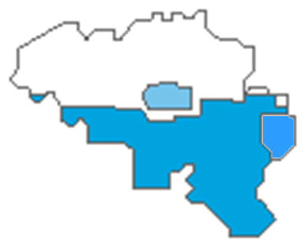






The Belgian R&I landscape is
a complicated landscape
German Speaking Community
French Speaking Community
COMMUNITY LEVEL
Basic Research
Flemish Community
REGIONAL LEVEL
Applied Research
Wallonia
Brussels
Flanders
FEDERAL LEVEL
Basic & Applied Research - FSIs

Slide 3

3 different levels are competent
Regions
Federal
Communities
Flemish Region;
Walloon Region;
Brussels-Capital Region.
Flemish Community;
French Community;
German Community
Research related to:
Economy; energy; public works; environment; transport; support to basic technological & industrial research
Space & nuclear; Federal Scientific Institutes; infrastructures; regulatory frameworks and R&I tax incentives
Education; healthcare; culture; research performed in higher education institutions

Slide 4
Belgium invests (a lot) in R&D
Overall R&D public funding
± 2,600,000,000 EUR

Slide 5
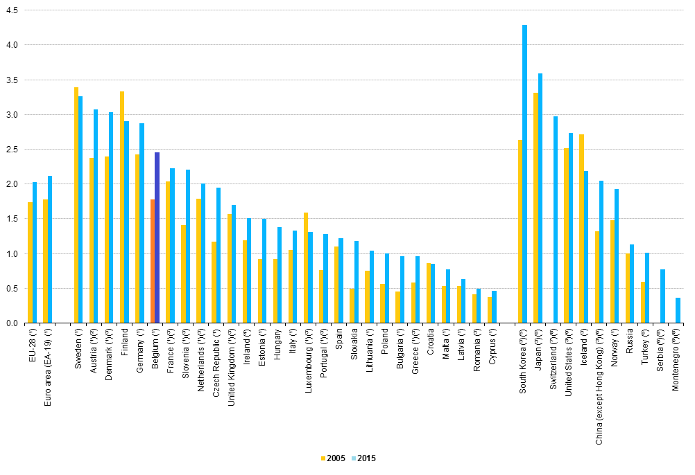
The Belgian R&I landscape
Research intensity:
2,45% of GDP
EU28 = 2,03% of GDP
6th EU member state

Slide 7
Some important policy measures
  On the federal level:
  Reform of the federal science policy
  more autonomy for the FSI’s
  creation of a new space agency
  integration of BELSPO in the Ministry of Economy

Slide 8
Some important policy measures
In Brussels
Regional Plan for Innovation of the Brussels-Capital Region 2016 - 2020
  “Brussels, Capital of Innovation”
  3 strategic priority areas reflecting Brussels's strengths:
  Health - Personalised medicine
  Environment - Green economy
  ICT – Digital economy

Slide 9
Some important policy measures
In Wallonia
New smart specialisation strategy: "Towards a regional policy for sustainable industrial innovation“.
  Marshall Plan 4.0 (Smart Specialisation Strategy)
  Creative Wallonia (2010): creativity and entrepreneurship
  Digital Wallonia (2015): digital programme
  NEXT Programme (2016): support to circular economy
  Internationalisation through WBI & AWEX

Slide 10
Some important policy measures
In Flanders
Strategy Flanders: Vision 2050.
Circular economy
Smart living
Industry 4.0
Lifelong learning and a dynamic professional career
Healthcare and welfare
Transport and mobility
Energy

Slide 11
Thank you for your attention!

