Slide 1

Cooperation instruments China - F.R.S.-FNRS
Joël Groeneveld
European and International affairs
1st China-Belgium Innovation Dialogue
Brussels, 30th of March 2017

Slide 2
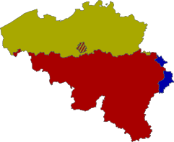








Research Funding in Belgium
Belgium is a federal state…
3 Communities
3 Regions
The FNRS funds basic research within the institutions from the French Speaking Community / Walonnia-Brussels Federation

Slide 3
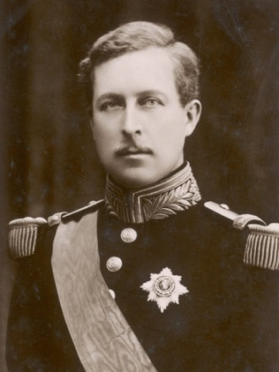

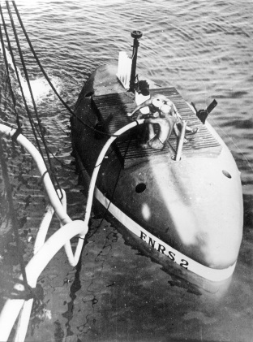
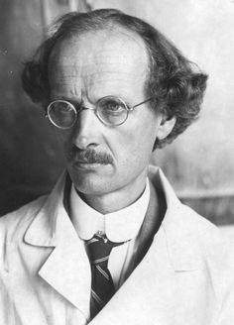

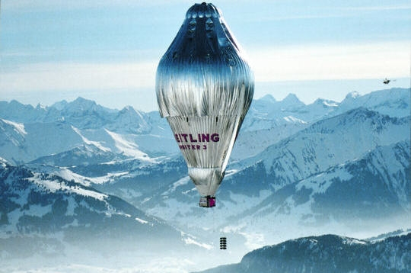
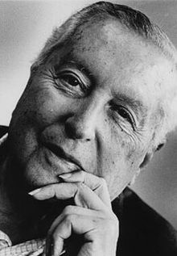
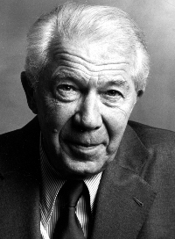
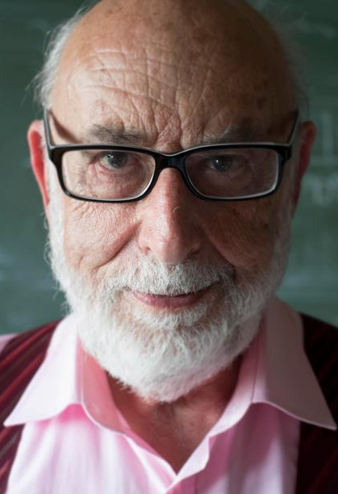
FNRS History Since 1928
1977
Dissipative structures
Complex systems
Irreversibility
1974
structural and
functional
organization
of the cell
2013
origin of mass of
subatomic particles

Slide 4
FNRS: Major Facts & Figures
Annual budget: ~180 M€ (90% public funding)
Funding instruments: fellowships, grants, international cooperation & mobility
~2.300 scientists (from PhD to tenured) hosted within the 6 institutions
1.500 PhD students
300 Post-docs
400 tenured
2 regular calls / Year: Fall & Spring
10,000 experts for peer reviews
4500 proposals processed / year
14 Scientific Panels

Slide 5
FNRS Panels & Nomenclature
ERC based nomenclature
http://www.frs-fnrs.be/docs/Reglement-et-documents/FRS-FNRS_Champs_descripteurs.pdf
SHS: Social Sciences and Humanities
SEN: Exact and Natural Sciences
SHS-1: Sociology, Demography
SEN-1: Structure, Fluids, Nanosciences
SHS-2: Cognition, Psychology
SEN-2: Mathematics, Physics
SHS-3: Literature, Philosophy, arts
SEN-3: Computer sciences
SHS-4: Archaeology, History
SEN-4: Natural sciences
SHS-5: Economics, Law
SVS: Medical and Life Sciences
IDR: FORESIGHT
Research project aiming at addressing a problem related to sustainable development
SVS-1: Molecular biology, Biophysics
SVS-2: Physiology, Immunology
SVS-3: Neurosciences
SVS-4: Aetiology, Public Health, Clinical sciences
Each panel is composed as follows:
1 President outside WBF
12 members with a minimum of 2/3 foreigners

Slide 6

Calls & Opportunities
Call for Fellowships
Opening: December
Closure: February
Panels: May-June
Results: July
Call for Grants
Opening: Early May
Closure: Late June
Panels: October - November
Results: January
Aspirants
PhD students
Staff: selected by the PI
PhD students
4yrs
Post-docs
Chargés de recherche
Post-docs
Mobility Post-docs
3yrs in 6yrs
Less than 24 months in Belgium during the last 3 years
Chercheurs qualifiés
Research associates
Consumables
Equipment
Tenure position
International calls (ERA-Nets, JPIs, …) based on EU agenda

Slide 7
Calls: Facts & Figures
Applications and success rates
# APPLICANTS
PhD students
Post-docs
Tenure positions
AVERAGE SUCCESS RATES
PhD students: 18-20%
Post-docs: 15-20%

Slide 8



Calls: Facts & Figures
International candidates
62 Nationalities
48% of applicants to post –doc positions got their PhD in another country
46% of the selected post-docs got their PhD in another country
28% of applicants to PhD student positions got their PhD in another country
20% of the selected PhD students got their PhD in another country
60% of applicants to Post-doc positions are foreigners
29% of applicants to PhD student positions are foreigners
2015: 60%
Steep internationalisation of our Post-doctoral calls since 2011
2011: 39%

Slide 9
Bilateral Cooperation with China
Chinese Academy of Sciences (CAS)
Chinese Academy of Medical Sciences (CAMS)
Chinese Academy of Social Sciences (CASS)
Natural Science Foundation China (NSFC)
China Scholarship Council (CSC) – with WBI
Agreements:
Short stays abroad (1 week to 1 month)
Only travel and subsistence costs (Travel for WBF researchers and fee for researchers from China (per diem)
Continuous submission (application 3 months before the stay) – agreement of the foreign partner required
Modalities:

Slide 10



Multilateral Cooperation with China
Joint Pilot Call:
Increase connections between Chinese and European research and innovation communities on urban sustainability
Design and test a framework for cooperation and implementation of joint calls
Initiate research and innovation projects to support the development of a longer-term roadmap for joint calls and cooperation
Aim:
Launch of the Call: November/December 2017
Deadline for Pre-registration: End of January 2018
Pre-check of eligibility: mid March 2018
Deadline for submission of the proposal: April/May 2018
Start of projects: Fall 2018
Calendar:

Slide 11
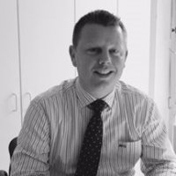


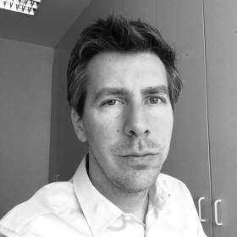

Contacts
Joël Groeneveld
International cooperation
Policy Officer
+32 2 504 92 70
joel.groeneveld@frs-fnrs.be
Arnaud Goolaerts
International & European affairs
Scientific officer
+32 2 504 93 28
arnaud.goolaerts@frs-fnrs.be
http://www.frs-fnrs.be/

