Slide 1
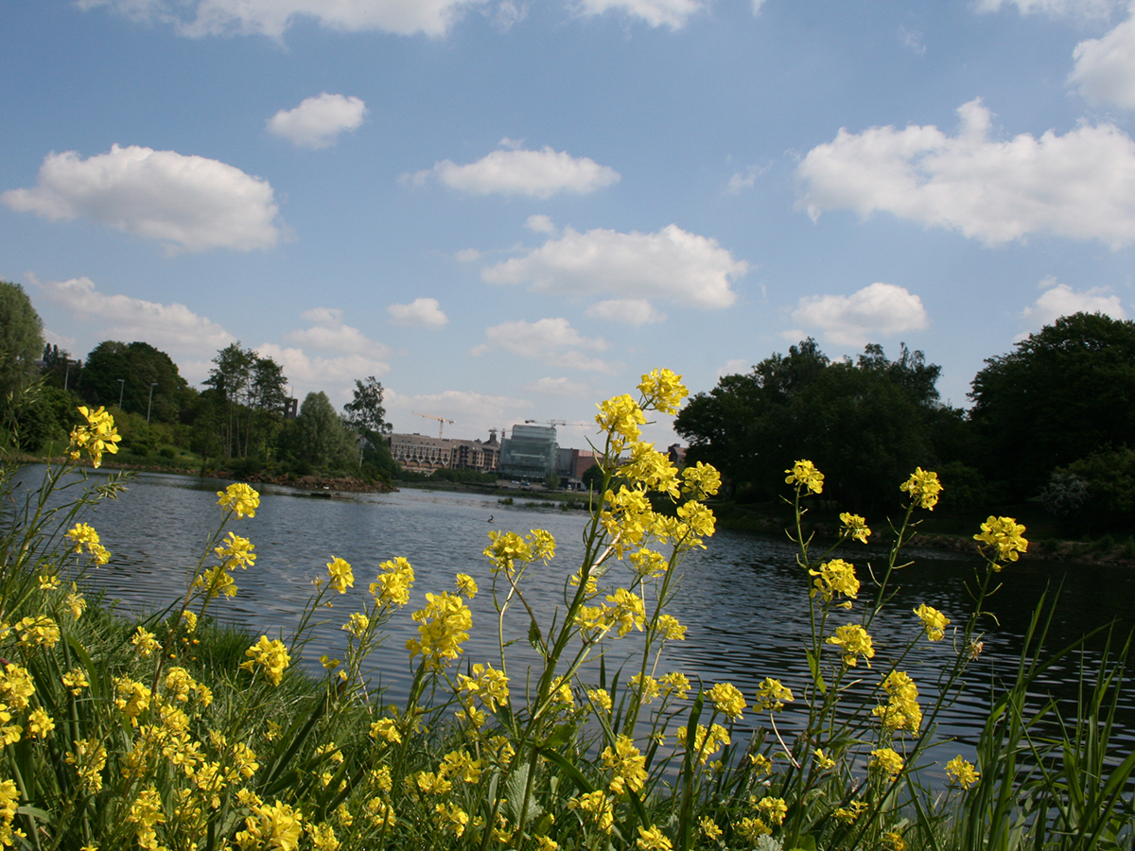
LLN SCIENCE PARK
CBTC PROJECT
The ongoing story
of a successful
sino-belgian cooperation

Slide 2
Science Park of the University of Louvain (UCL) and IBW
#1 Wallonia
1971
284 companies
6,420 jobs
231 hectares
5 Sectors +
Life sciences, engineering, fine chemicals, ICT, greentech
Facts & Figures

Slide 3
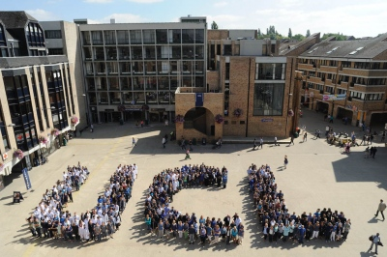
Close to Brussels
Access to EUR markets
Working Environment
> Research & innovation
Louvain Innovation Network
Brabant wallon #1 EU investor in R&D (11.36% GDP)
> Education & talents
UCL #1 french university in Belgium
Brabant wallon #2 most educated EU region
> Quality of Life
All-in-one-city concept
CBTC Project
Why LLN Science Park ?
Notes:
Dépenses R&D en % PIB – Eurostat 03/2016 (rapport basé sur chiffres 2013)
EU 28 = 2,03% → Objectif 2020 = 3%
Allemagne : Braunschweig = 7,33%, Stuttgart = 6%
Brabant wallon = 11,36% >< comparé à Namur et Luxembourg <1% !!!
Source: Eurostat Database “Regional Education Statistics”,
Title “Tertiary educational attainment, age group 25-64 by sex and NUTS 2”, update 30/08/2016

Slide 4
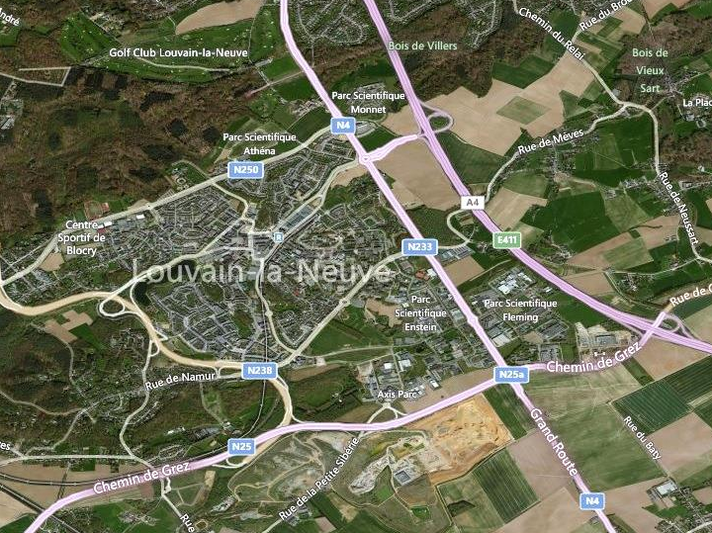
Central & strategic location in the science park
CBTC Project
Location in LLN SP

Slide 5
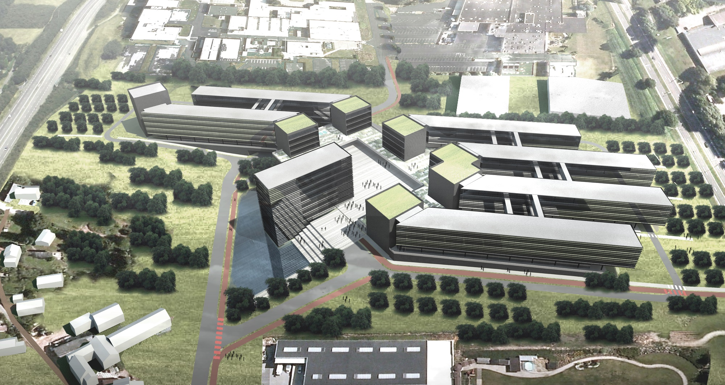
CHINA-BELGIUM TECHNOLOGY CENTER
Unique in Europe I Great chinese FDI in Belgium I
« Two-way gateway » for high-tech companies between our countries
CBTC Project
Master Plan (10 y)

Slide 6
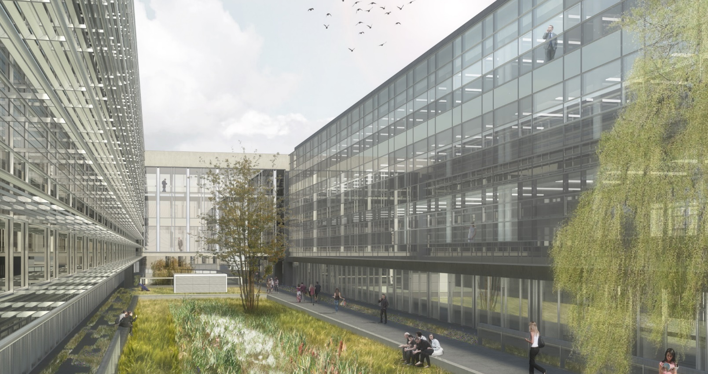
Offices 17,654 sqm I Conference room 1,088 sqm I Hotel 10,048 sqm
Shops 4,254 sqm I Technical rooms 5,399 sqm I 550 parking slots + P bicycles
CBTC Project
Phase 1

Slide 7
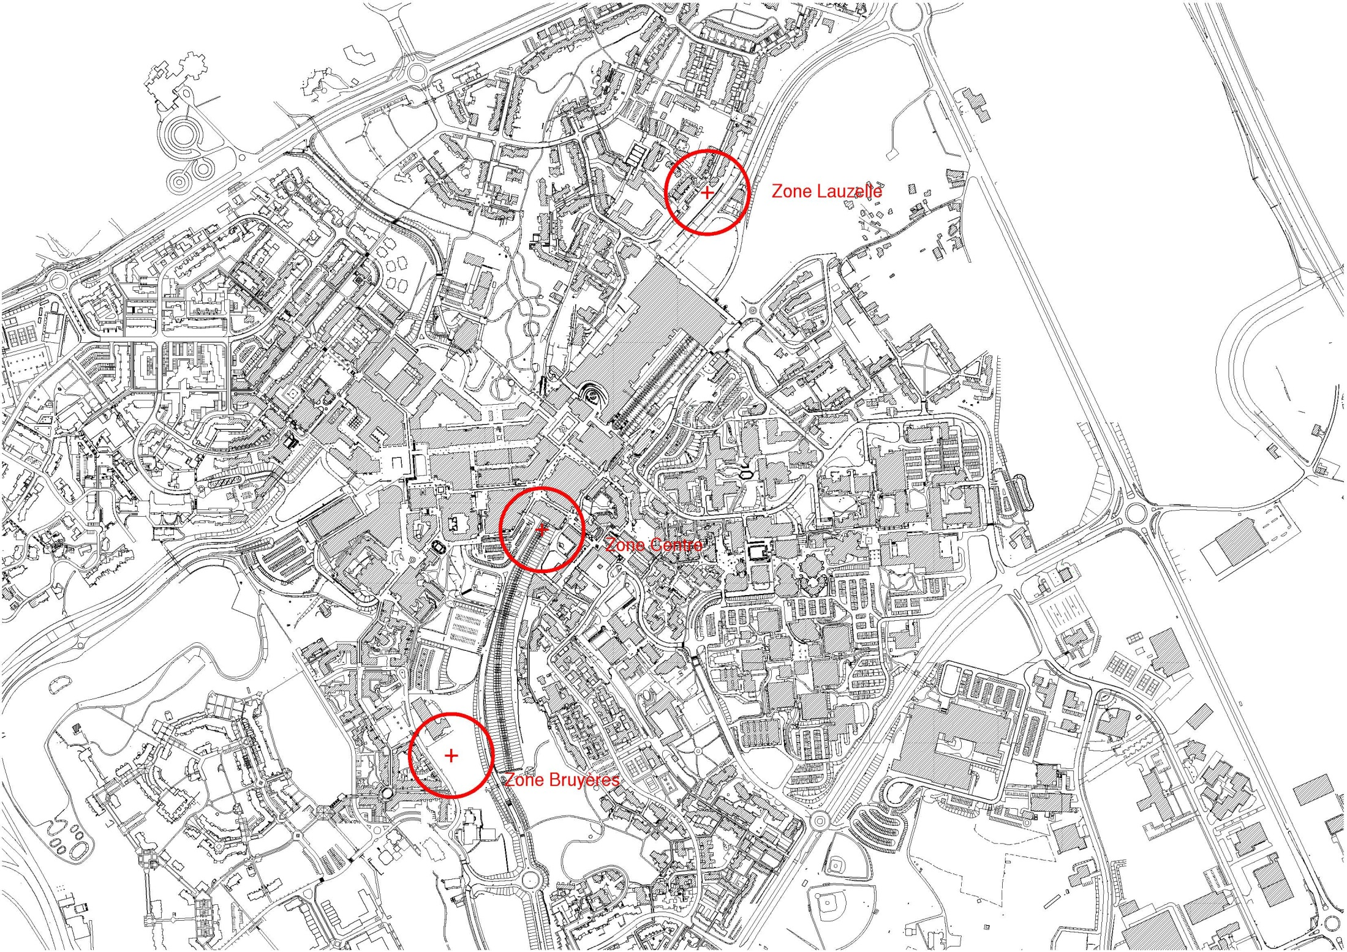
+ 3 residential locations to accommodate
450 chinese long-term expatriates
CBTC Project
Locations in City Center

Slide 8
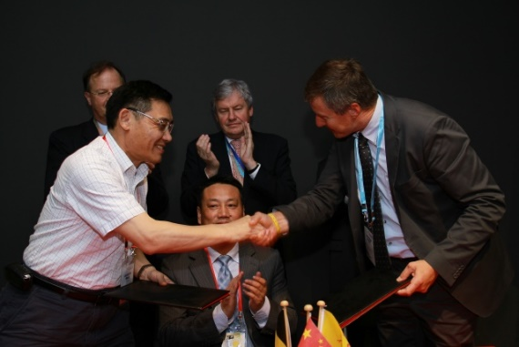
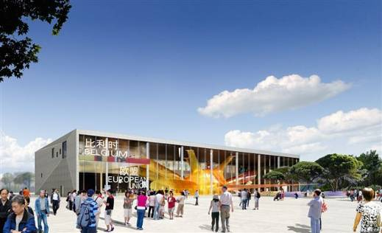
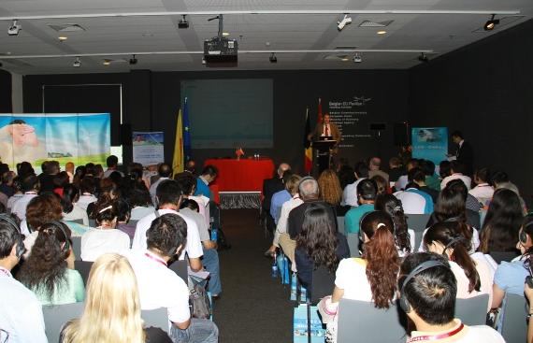
GREAT MILESTONES
2010
Science Parks of Wallonia @ Shanghai Expo

Slide 9
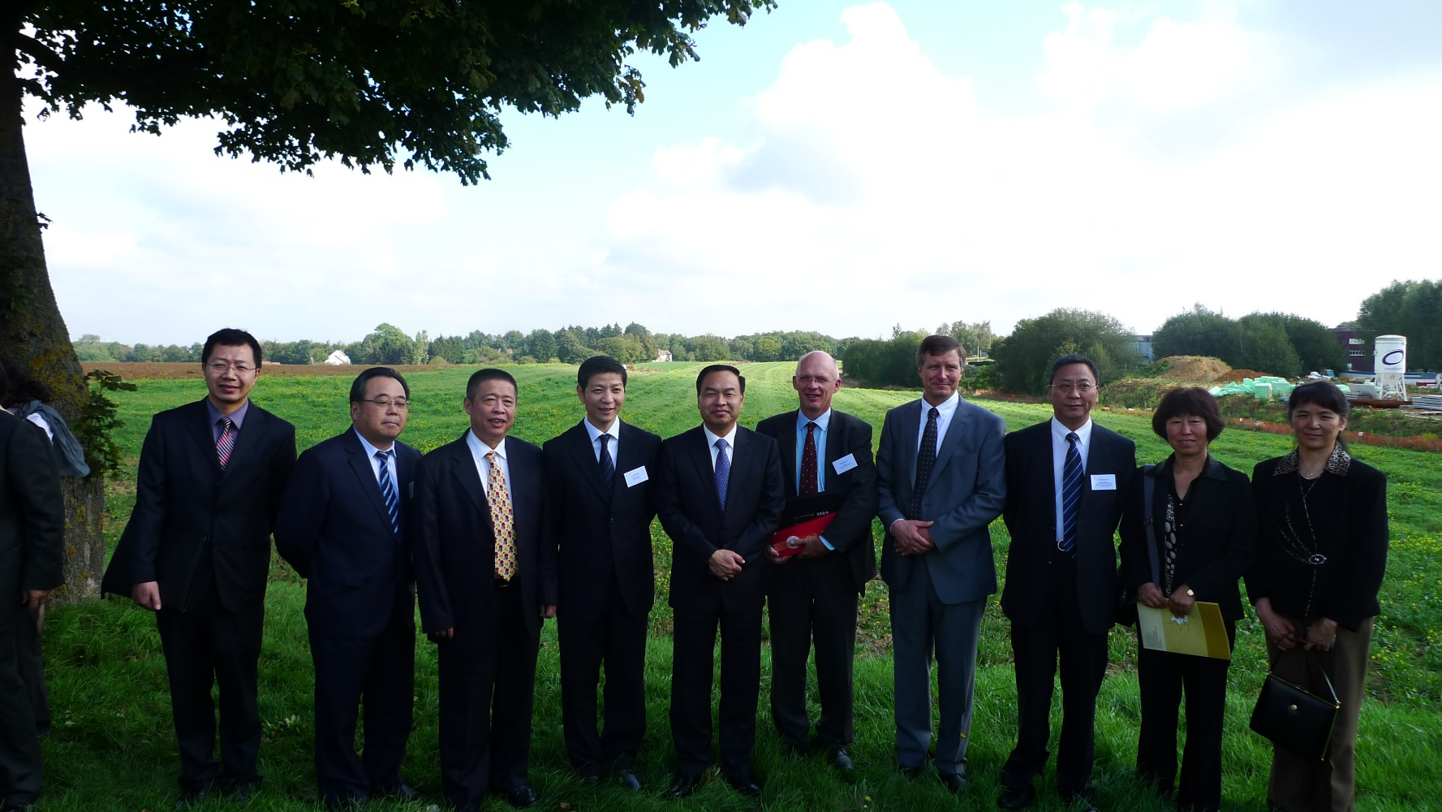
GREAT MILESTONES
2011/09
Visit of Wuhan Mayor Mr Tang

Slide 10
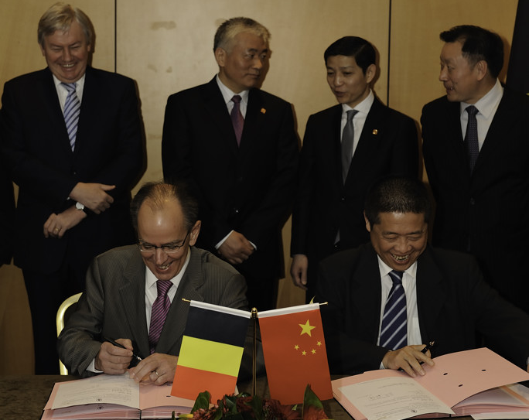
GREAT MILESTONES
2012/04
CBTC Agreement : Land emphyteusis (promise)

Slide 11
GREAT MILESTONES
2014/03
CBTC Agreement : Cooperation Framework

Slide 12
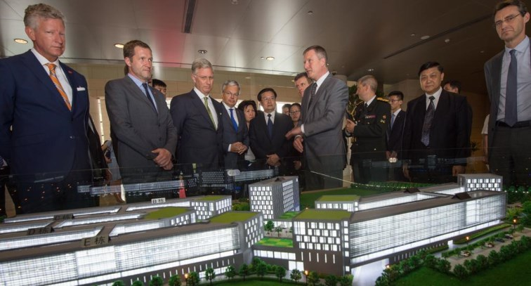
GREAT MILESTONES
2015/06
CBTC presentation to Belgian King Philippe in Wuhan

Slide 13
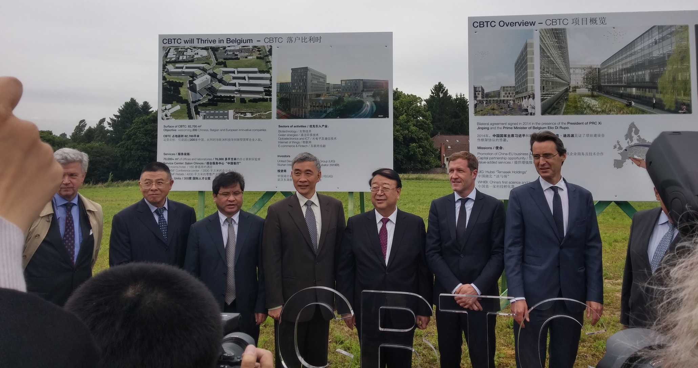
GREAT MILESTONES
2016/06
CBTC Offical Launch

Slide 14
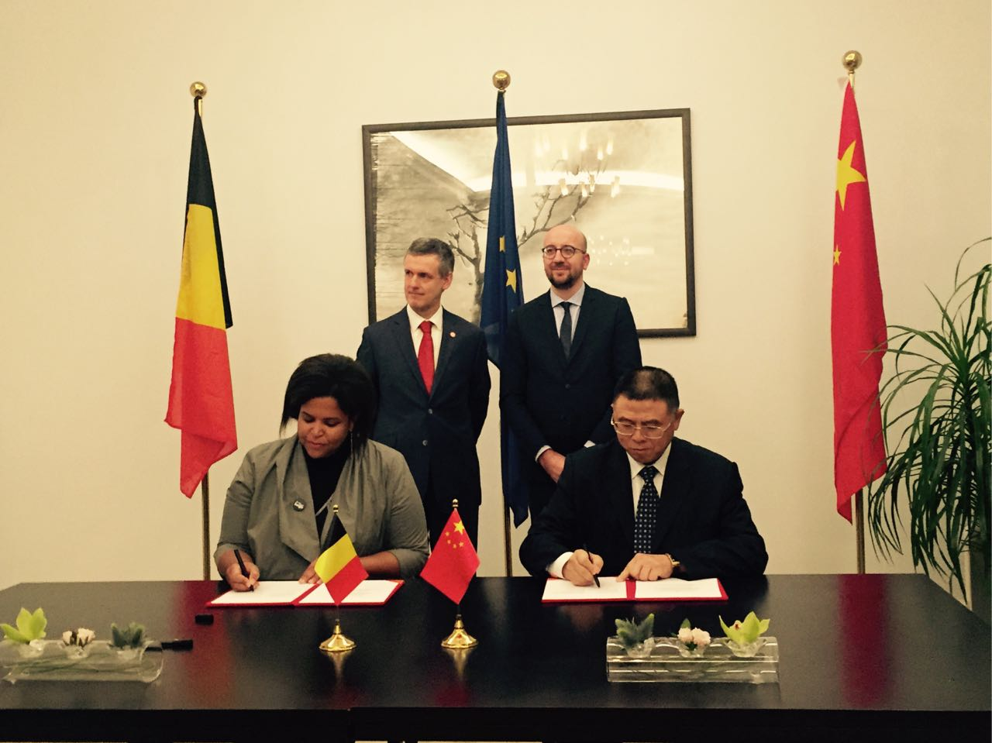
GREAT MILESTONES
2016/10
CBTC Agreement : Cooperation UIE-AWEX

Slide 15
Relations with China
> 49 visits from China in the last 6 years
> 9 Chinese companies already in the science park
Biggest : Huawei R&D Center
UCL has…
> 67 cooperation agreements with China
> +- 60 chinese students
> Country focus : role of China Desk
CBTC Project
LLN Science Park

