Slide 1

China-Belgium Technology Center
中国-比利时科技园(CBTC)
the Go-to Platform for Hi-tech China-EU Innovation & Cooperation / 中欧高科技企业创新合作的平台
CBTC

Slide 2

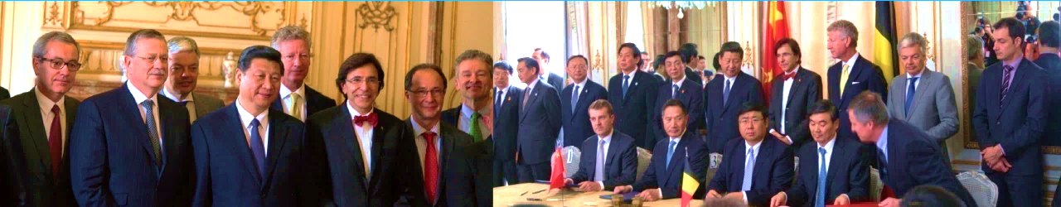
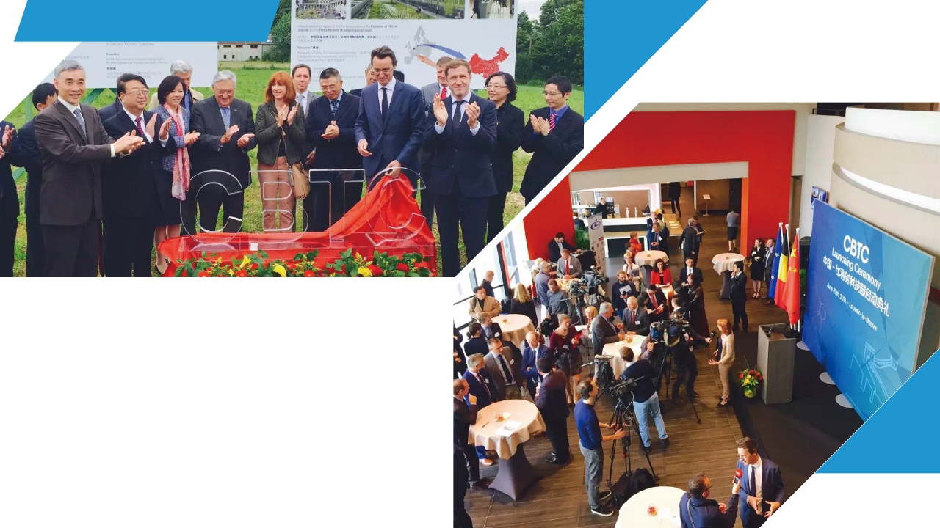
State Attention on CBTC
中比科技园聚焦两国关注
级关注
On March 31, 2014, President Xi Jinping and Prime Minister of Belgium Elio Di Rupo witnessed the signing of the Cooperation Framework Agreement on Building China-Belgium Hi-tech Incubation Park.
2014年3月31日,习近平主席访问比利时期间,与比利时首相埃利奥•迪吕波共同见证《中国-比利时高科技孵化园区建设合作框架协议》签署。
In June 2016, United Investment Group held the initiation ceremony and press conference for CBTC Science Park in Louvain-la-Neuve of Belgium. Wallonia government leaders, Chinese Ambassador in Belgium attended the ceremony.
2016年6月，联投集团在比利时新鲁汶项目现场举行了CBTC科技园启动典礼和新闻发布会，瓦隆大区政府，中国驻比利时曲星大使等出席。
.

Slide 3


CBTC Strategic Position
中比科技园战略定位
The go-to platform and workstation for China-EU hi-tech company cooperation, including strategic investment, industry cooperation on R&D and partnership, tech transfer, and mutual market entry etc.
CBTC科技园致力于搭建中国和欧洲企业合作的平台及工作基地，通过构建双向绿色通道，为双方战略投资，行业合作,研发，技术转移，及市场准入提供支持。
Strategic Position
战略定位
Key Sectors
目标产业
CBTC focuses on the following sectors: biotechnology, ICT, clean energy, smart manufacturing.
科技园重点支持以下领域中欧企业：生物技术, 通信技术, 清洁环保技术, 智能制造。

Slide 4
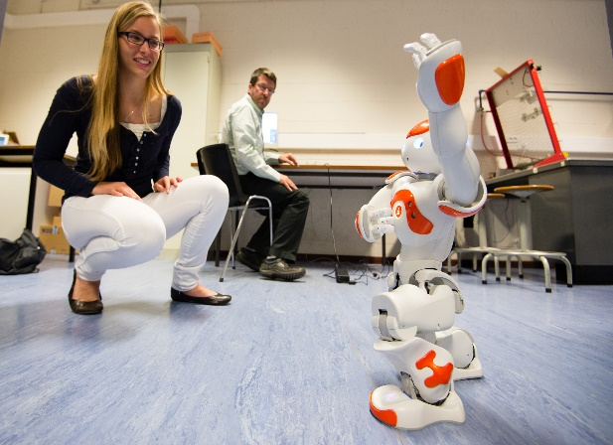
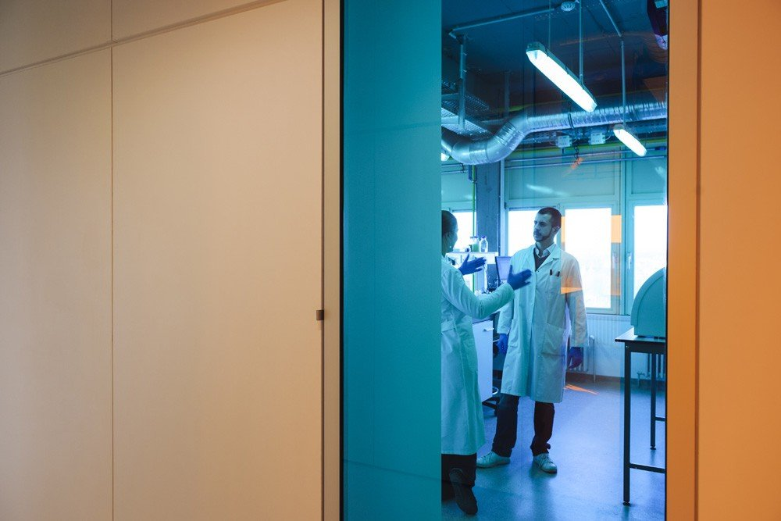
Competitive Advantages for Chinese Investors /中国投资者
Location/交通区位
CBTC is located in the city of Louvain-la-Neuve , Belgium, only 30 kilometers away from Brussels, “capital of Europe. Thanks to its comprehensive transportation network, all EU metropolitan cities can be accessed at ease
Subsidies, Deduction and Incentives 投资税收优惠及研发补助
The government introduced a series of attractive investment subsidies and tax preferential policies for companies that are willing to locate in Wallonia.
R&D Environment/ 研发环境
Adjacent to LLN Science Park and UCL and other research centers, CBTC has a very good R&D environment for future companies
Industrial Alliance/产业集群
The area of CBTC region has developed a successful clustering policy, supporting 6 competitiveness clusters to carry out investment, R&D or training projects in 6 clusters, especially in life science, mechanical engineering , environmental science.

Slide 5
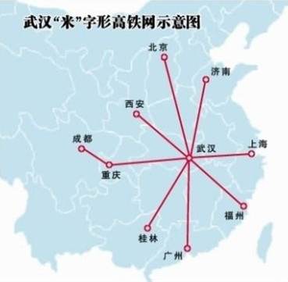

Competitive Advantages for International Companies/外国企业
Location/交通区位
Hubei Province is the strategic point for the central region of China and Yangzi River economic belt. Wuhan city, the capital of UI Group, is the national hub for transportation and logistic connections.
Integrated Acedemy, Research & Industry Alliance 产学园一体联盟
Surrounded by famous universities such as Wuhan University, Huazhong Science & Technology University, and 71 national level scientific research Institutes, now over 2,000 hi-tech innovative companies are located here thanks to the presence of WHIBI and Optical Valley.
Resources for Market Entry & Expansion/市场准入及扩张
As the largest state owned enterprise in China, UIG and another shareholder WHIBI can offer resources for international companies in terms of market entry, partnership, government relationships etc, which can be further expanded to other major cities in China.
Optics Valley
China Hubei Wuhan East Lake High-tech Zone

Slide 6








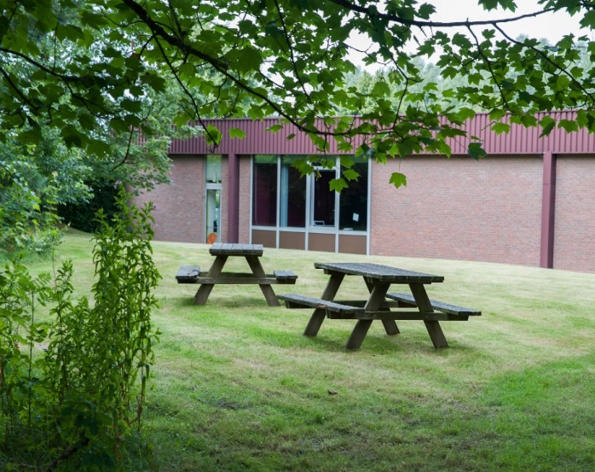
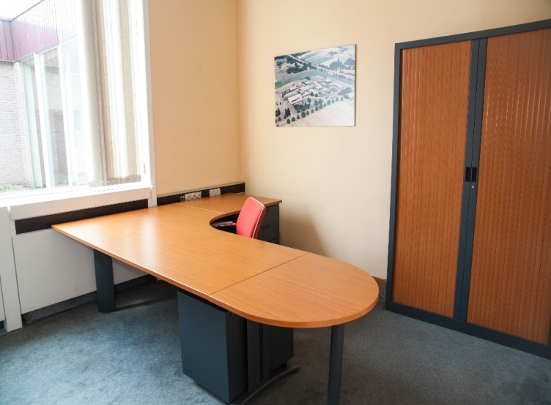
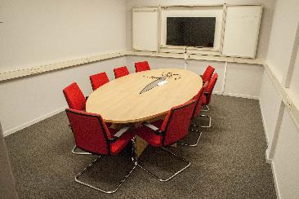
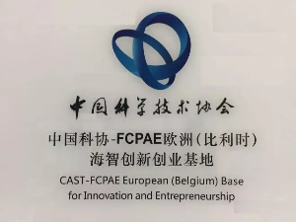
BAROC Incubation Center
巴洛克高新孵化园区
BAROC Hi-tech Incubation Park is the working base of “Overseas Innovation and Entrepreneurship” European (Belgium) for China Association for Science and Technology.
It covers the construction area of 2200 m² , and more than 20 innovation enterprises from both China and Belgium joined.
BAROC中欧示范园区建筑面积2200平方米，已驻有中比创新创业企业20余家。中国科协“海外创新创业”欧洲（比利时）工作基地也特设于此。欢迎中欧企业入驻垂询。

Slide 7
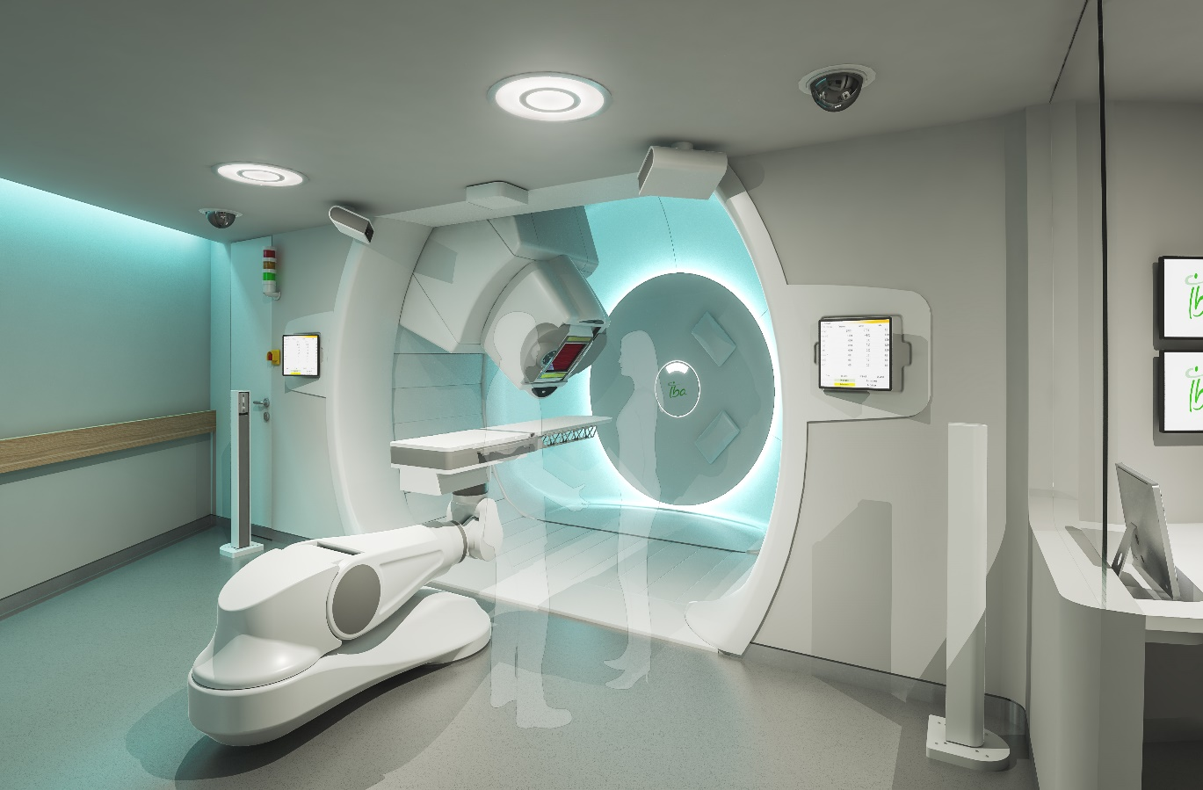
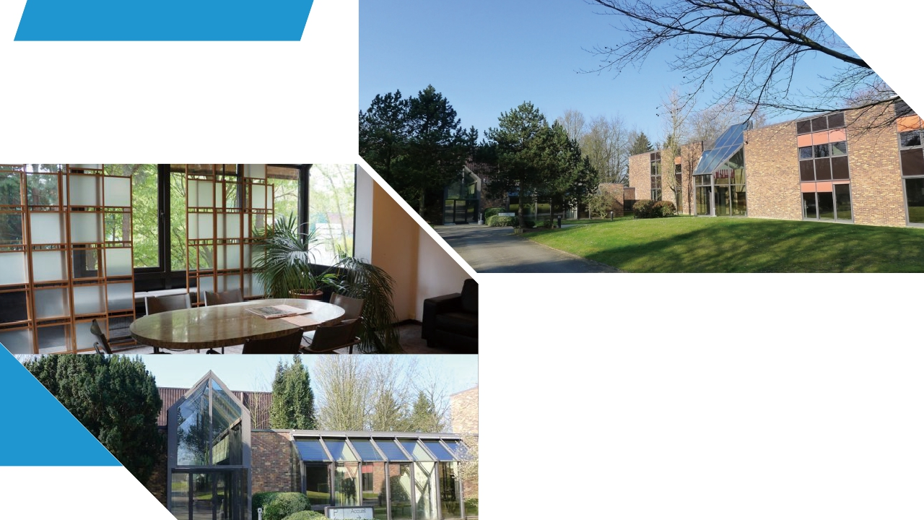

SBIRD Innovation Base
SBIRD 创新基地
SBIRD创新示范基地
-全球生物医药行业领军企业IBA整体进驻
SBIRD Innovation Base has been rented out to IBA
SBIRD Innovation Base covers the construction area of 1800 m², and it is now rented out to IBA. Founded in 1986, IBA is a high-tech company incubated from UCL’s Accelerator Laboratory. It aims at cancer diagnosis and treatment technology and enjoys a leading position in proton therapy.
SIBIRD 建筑面积1800平方米。租户IBA集团成立于1986年，是新鲁汶大学加速器物理实验室孵化的高科技公司，致力于癌症诊断和治疗技术，在质子治疗领域具有世界领先地位。

Slide 8
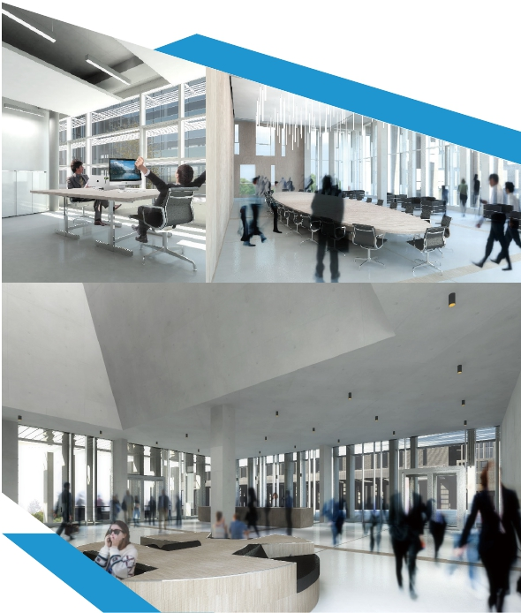
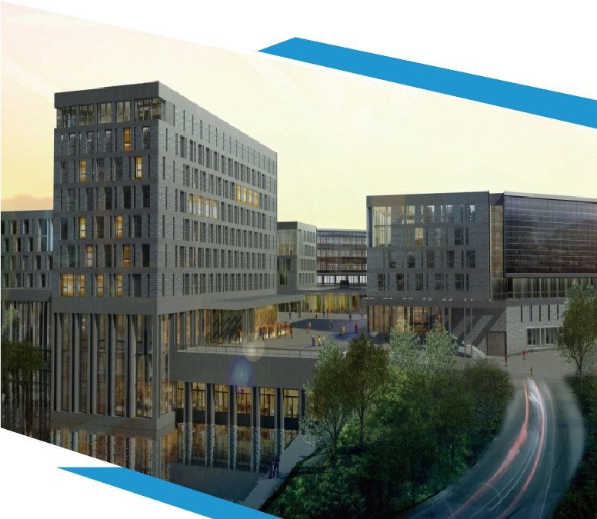
CBTC Smart Valley
中比科技园智慧谷
CBTC Smart Valley- the biggest science park project invested by China in Belgium.
CBTC智慧谷 -中国在比利时投资的最大科技园项目.
7万方办公研发楼
70,000 m2 research and development oﬃce building
容纳200多家中欧创新企业
Accommodate more than 200 China-EU companies
欢迎3000多名专业人才
Welcome more than 3,000 professionals
酒店会议及共享办公配置满足多重需求
Hotel , Conference & Co-sharing Space for multiple needs
300套公寓满足企业需求（45-150m2)
300 developed apartments to meet company needs
舒适环境营造创新氛围
Comfortable working environment with innovative atmosphere

Slide 9
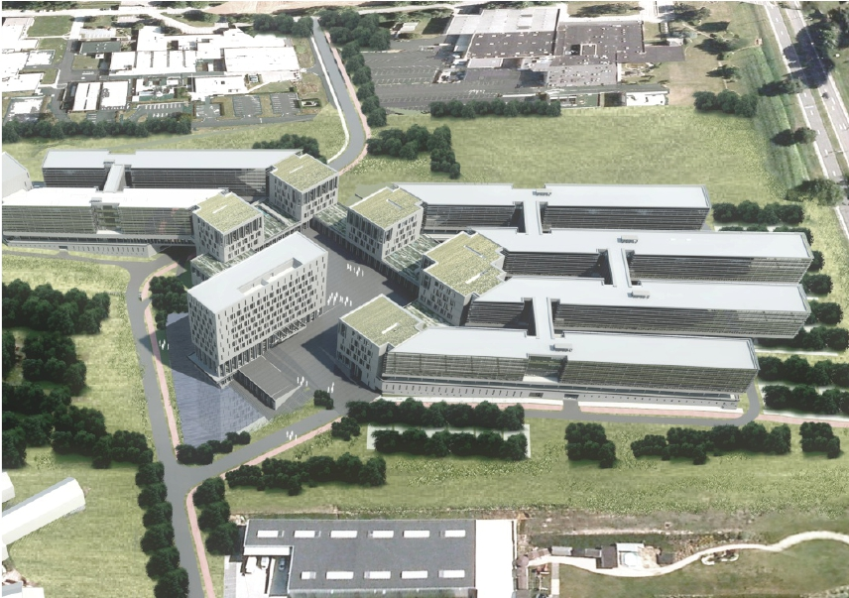
Coference Center
Business Center
Labs
Co-working Space
Hotel
Offices

Slide 10


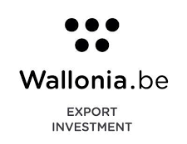










Partnership
Construction
Business
R&D

Slide 11
One Stop Service
一站式服务
CBTC will provide one-stop service for China and EU enterprises, helping them to expand the market more easily：
CBTC将为中国及欧洲企业提供双边一站式服务，帮助入驻企业快速便捷拓展市场：
1. Office Development & Construction: tailor made office buildings, small and co-sharing working space for start-ups.
开发建设：楼宇定制，办公空间装修定制，小型及共享办公空间。
2. Science Park Operation: IT, meeting & event management, catering, fitness, car rental, networking, childcare center.
园区运营：IT通讯，会务管理，物业管理，餐饮，健身休闲，汽车租赁，企业社交平台，托幼所。
3. Financial Service: Bank loans, financing guarantees, venture capital, funds and government allowance application
金融服务：银行贷款，融资担保，风险投资，保险，基金及政府补贴申请
4. Incubation Service:
Landing service ( business plan, company set-up, work permit, transportation & housing)
Consultancy service( preliminary market research, key industry focus, China-EU company database , technology transfer/M&A/ integration, R&D project match & management, hi-tech achievement commercialization, product production, transaction negotiation, tax, law)
Training service( EU laws & regulations, business and social etiquette, EU culture, languages)
HR service ( talent introduction, human resource management)
企业孵化：
a.落地服务（商业计划，公司设立，工作许可，交通住房）
b.咨询服务（市场前期调研，重点行业监测，中欧企业资源库，技术转让/并购及整合，企业研发项目对接及管理，技术成果商业转化，产品推广，交易谈判，税收，法律）
c.培训服务（欧洲法律法规，商务及社交礼节，欧洲文化，语言）
d.人力资源服务（人才引进，人力资源管理）

