Slide 1
3/30 Morning:
SMIC and Imec Collaborations
Min-hwa Chi, Ph.D.
SVP/ETD , SMIC
Mar 30th, 2017

Slide 2
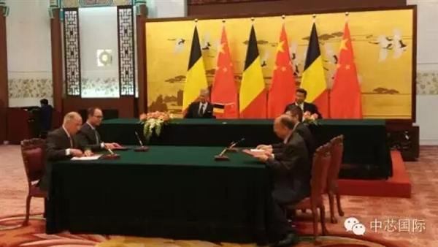
SMIC-IMEC collaboration
Signed collaboration contract: Jun 2015
1) SMIC/Qualcomm/Huawei/IMEC.
2) Joint development SMIC&IMEC.
First round of Investment: in Nov 2015, SMIC, Qualcomm, Huawei, and IMEC completed the 1st round of joint venture investment with a combined capital of $99M.
Notes:
Notes : IP transfer from imec Leuven. Limited burden on Leuven team. Focus on leveraging existing data from current development
Day-day interaction and technical direction support by on-site team. Focus on providing technical support on issues, improving baseline process & tracking progress

Slide 3


SMIC-IMEC DEVELOPMENT MODEL
IMEC IP transfer – Workshop, patterning & process training, conf. calls, data exchange
IMEC on-site – Technical experts on-site
SMIC – Existing technical expertise at SMIC
IMEC IP Transfer
SMIC
  Joint teams working on hardware, process
  definition & data analysis:
Regular progress update
Detailed plan for program timeline & deliverables
Quarterly face-face technical & management review
14nm Joint
Development
IMEC
on-site
Notes:
Notes : IP transfer from imec Leuven. Limited burden on Leuven team. Focus on leveraging existing data from current development
Day-day interaction and technical direction support by on-site team. Focus on providing technical support on issues, improving baseline process & tracking progress

Slide 4

14nm JDP status
Model for successful JDP demonstrated
  Good cross team interaction established
  Joint ownership of key milestone
  Expertise leveraged across both locations
  Regular progress update & executive interlock
Good Overall Progress in 2016
  Device performance on track
  Wafer level reliability on track
  Defect step-down progressing well
  Significant (>3x) Cycle-time improvement

Slide 5
Summary: Current Collaboration status and progresses
Collaboration with IMEC, joint development on 14nm FINFET. IMEC has total 5 experts on-site support ing SMIC and deeply involved in the 14FinFET technology development.
IMEC headquarter (Belgium) technical team: remotely supports SMIC 14FinFET project.
Quarterly f-to-face meeting: to review technology development status: 2 at Shanghai (SMIC), another 2 at Leuven (IMEC).
Current Joint Development Project (JDP) SMIC 14nm status:
  Finish 14nm baseline process setup; all critical tools are ready.
  Successfully setup CMOS and Multiple-work function devices and get electrical qualifications. Both NFET and PFET performance <10% gap to target.
  Pass all FEOL process reliability test; BEOL passes 60%.
  Released PDK 0.01 (including DR/DRC, LVS/PEX, and SPICE); applied to RC07 TQV design; Started running 1st lot of TQV vehicle (RC07); and M1 data will come out before M/Apr.
  R777 vehicle get SRAM Yield improvement and progress significant, predict 8M SRAM yield break in Q2’17.

Slide 6



SMIC-imec JDP extended to 2018 in continued support of 14nm

Slide 7
3/30 Afternoon:
Future Industry: Foundry at China
Min-hwa Chi, Ph.D.
SVP/R&D , SMIC
Mar 30th, 2017

Slide 8
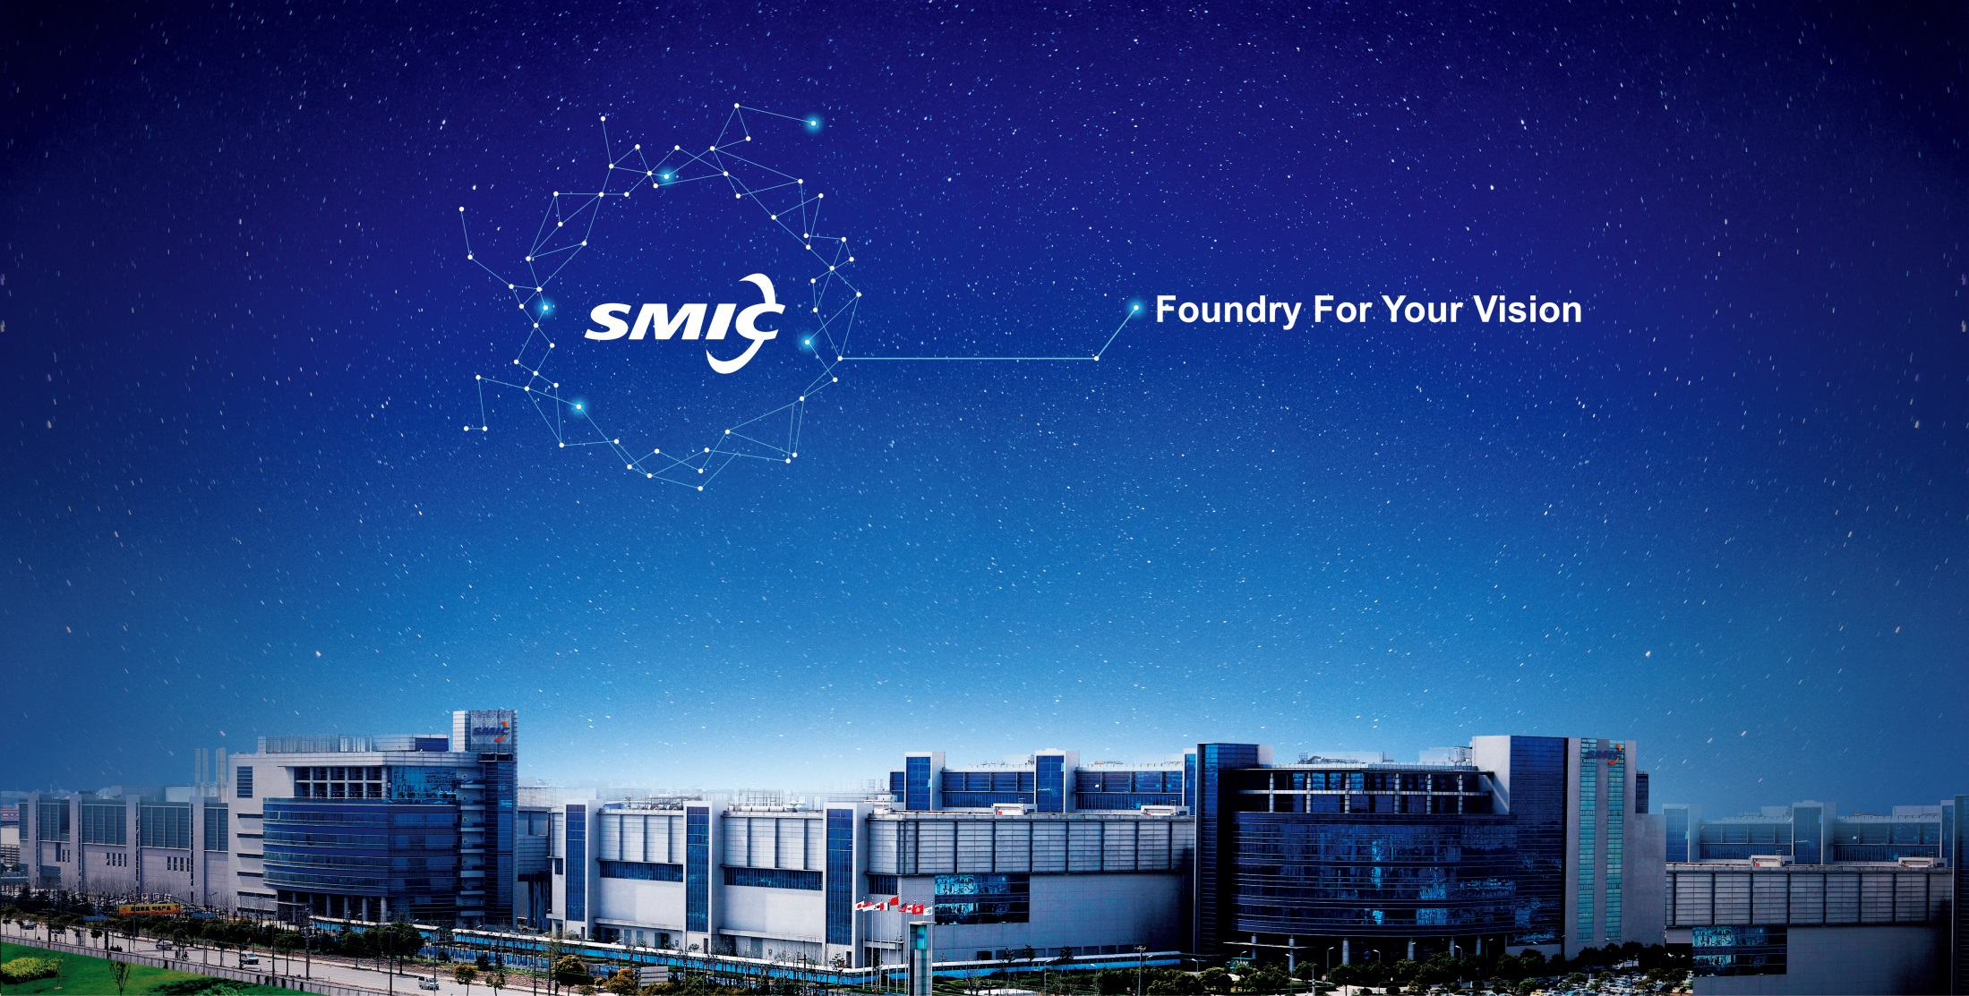

Semi-Industry at China in fast expansion;
SMIC’s Role as foundry;
IoT and SMIC’s technology portfolio;

Slide 9
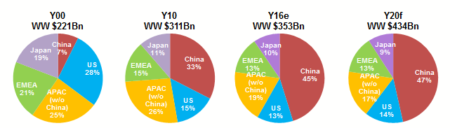
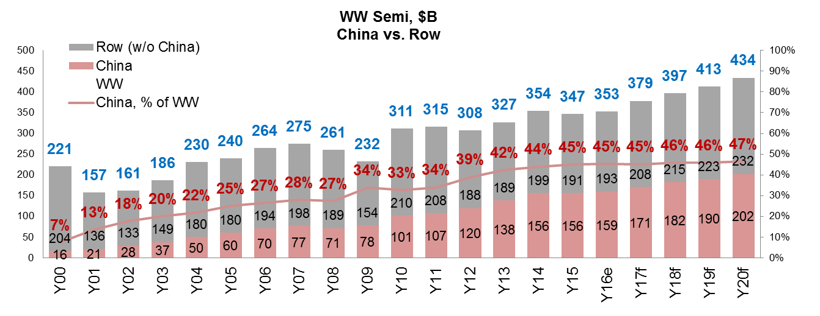
China is No.1 in the Worldwide Semiconductor Market
$B
CAGR Y16-Y20e
+5.4.%
%
Source: IHS AMFT 4Q16, Team Analysis

Slide 10
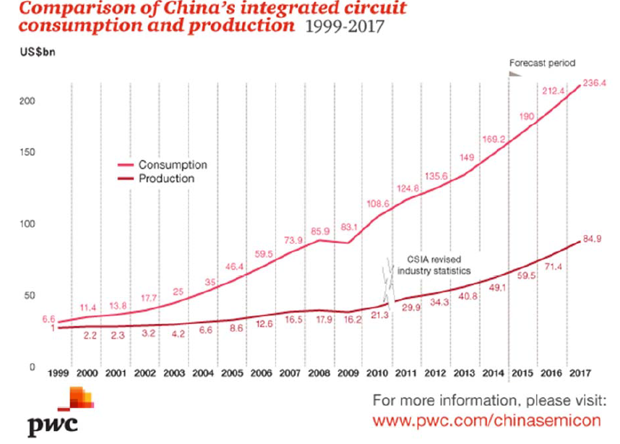
Foundry: Local production is much less than the needed consumption
Imported
Local

Slide 11
Foundry at China: in fast expansion mode
Electronics business accelerating Semi-Fab investment at China:
1. Large electronics production is still growing,..;
2. Triggering large demand of local semiconductor chips consumption, and thus attracting world-class IDM/foundry to invest Fab’s locally at China;
3. Further attracting back-end foundries at China (i.e. tools/materials, testing, packaging, bumping, module assembly, etc.)
4.The above cycles results in continuously growing cluster effect with competitive advantages of electronics production.
Supply-Demand
2. Need more Semi Fab’s:
- Invest more Fab’s
(Domestic and foreign foundry and IDM’s);
Wide scope (in Logic, NAND, DRAM, …etc.)
1st class IDM/foundry: Intel, Samsung, tsmc, UMC, …etc.
1. “Electronics” Production growing
Cost driven
Cluster effect
3. Attract more back-end foundries (i.e. tools/materials, Packaging, Bumping Module assembly, PCB, Testing, ... etc.)

Slide 12
Semi-Industry at China in fast expansion;
SMIC’s Role as foundry;
SMIC’s technology portfolio and IoT ;

Slide 13
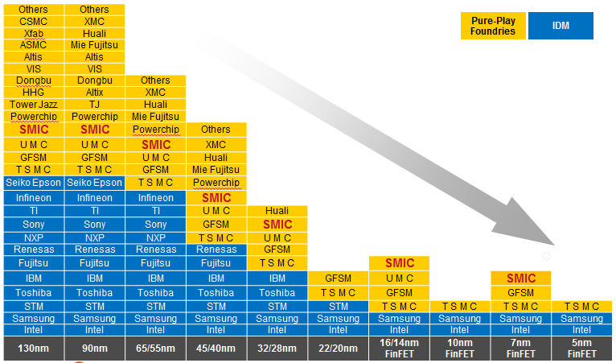
  SMIC is one of the few Pure-play Foundries on advanced nodes
Source: ARM, SMIC internal studies, 4Q16

Slide 14
SMIC Continues to Grow and Invest
Revenue Growth
CapEx Investment
$M
R&D Investment
$M
$M
* R&D excludes the funding of R&D contracts from the government and fab start-up cost

Slide 15
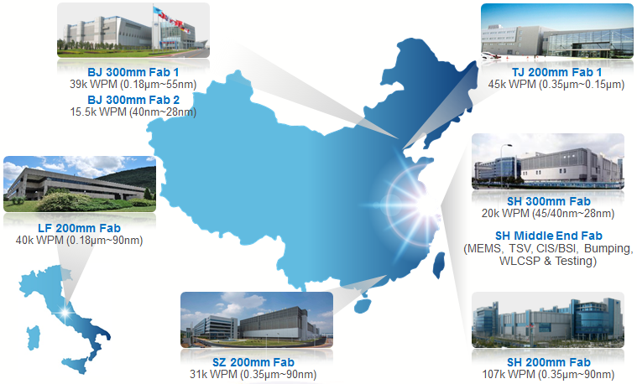
SMIC’s Fab Capacity: existing
15
Notes:
15
SMIC manufacturing facilities are located in China’s most developed areas and are close to end market places.
(Bohai Rim, Yangtze River Delta, and Pearl River Delta).
To match our business strategy for meeting future growth and customer demands, SMIC continues to invest for future fab expansions.
In particular, we now have Beijing 12” Fab B2 under equipment installation. We also have ShenZhen 8” began operation in 2014.

Slide 16
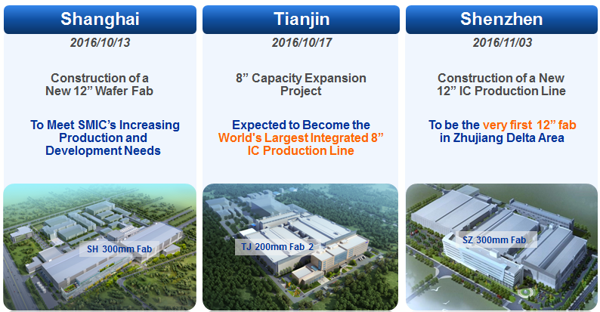
SMIC Fab Capacity: 8” & 12” Expansion Plan
16

Slide 17

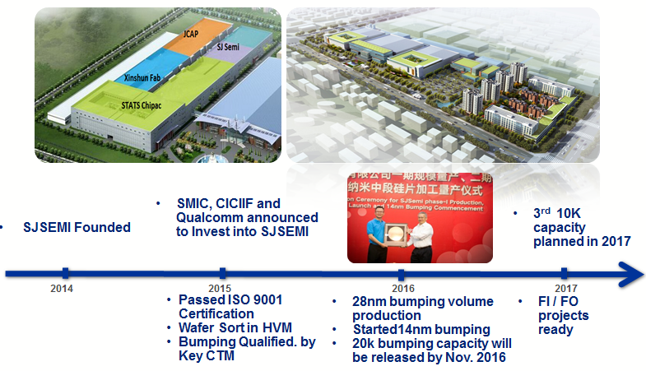
SJSEMI: Bridging China’s Semi Supply Chain
17

Slide 18









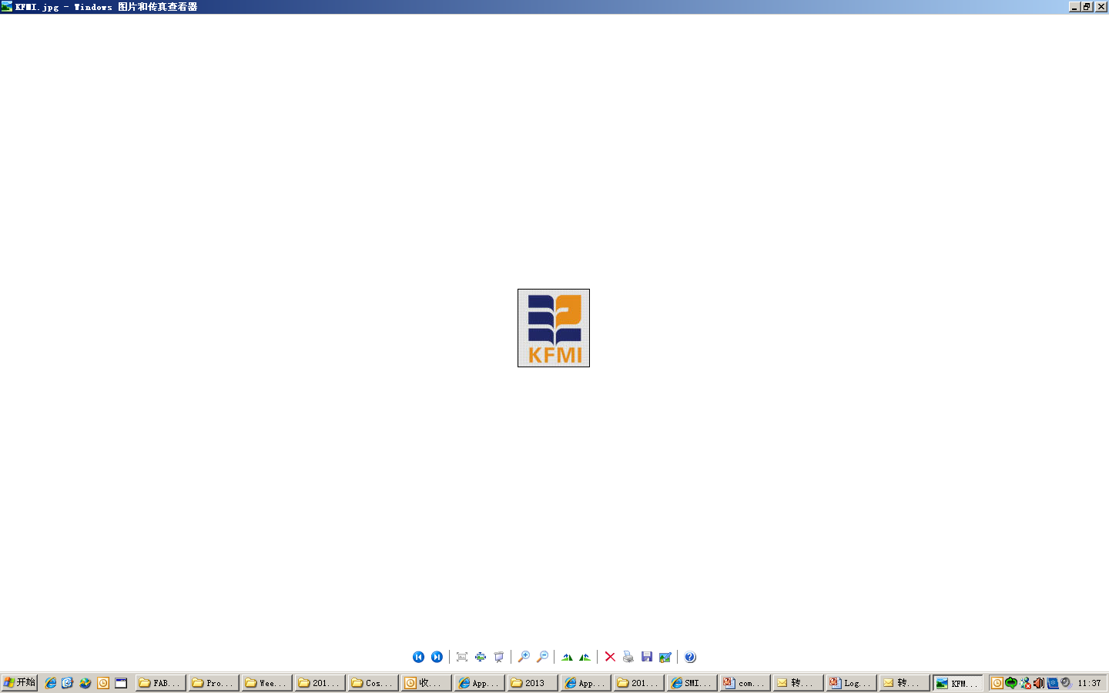

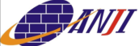




Strengthening Semiconductor Eco-Systems in China
Technology R&D
Design Service
Technology R&D Consortium with Universities, Research Academy, and Industrial Partners
Collaboration between SMIC and well-qualified design houses & partners to service customers
Increasing Purchases & Qualifications with local & global Suppliers
Technology Coverage:
0.35um ~ 14nm
12" Bumping & CP testing production line jointly built with JCET, with planned capacity of 100kWPM
Mid & Back-end
Material & Equipment
Vendors

Slide 19
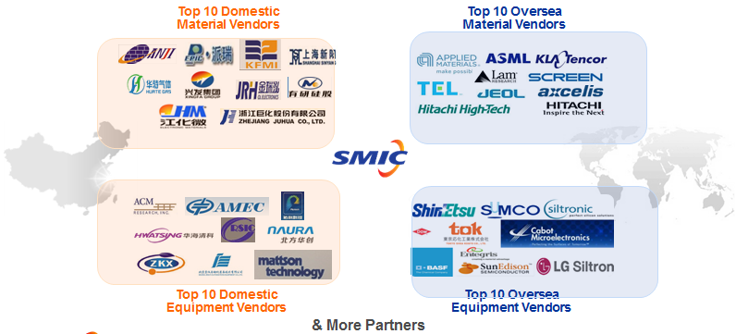
Collaboration with Global Vendors Continuously
SMIC welcomes domestic/oversea equipment and material vendors to collaborate in China and build Win-Win Partnerships with SMIC.
Collaborate with domestic/overseas suppliers on 28nm HKMG and 14nm processes.

Slide 20
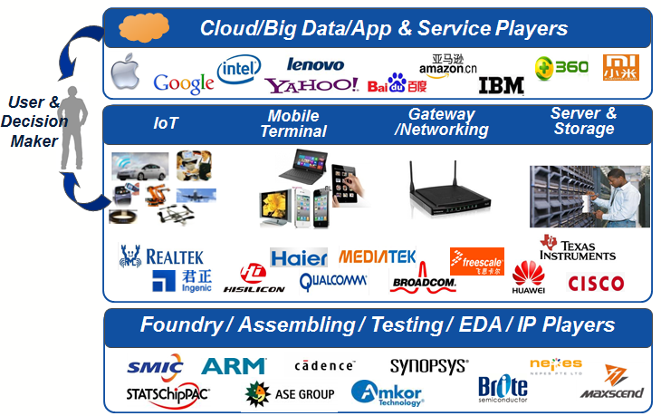
Collaboration in IC Ecosystem
Cloud / Software / Internet / App / IT Service / ISV

Slide 21



























































IP / EDA / Design Service Ecosystem
Worldwide and Local Leading partners with Excellence and Flexibility
IP
Alliance
EDA
Alliance
DS
Alliance
Notes:
Beside strong IP investment and development, SMIC also cultivates a well-established IP/EDA/Design Service Eco-system. In which, we co-work with many leading global and local partners to offer customers the combinations of products and service that best fit customers’ demands.
Contact: Abel S.

Slide 22
Semi-Industry at China in fast expansion;
SMIC’s Role as foundry;
IoT and SMIC’s technology portfolio;

Slide 23
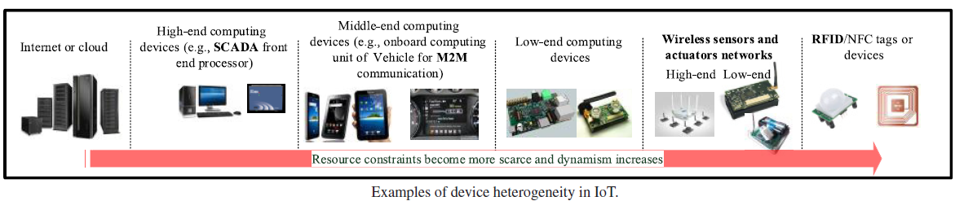
IOT: Foundry Technologies for Semiconductor chips
IoT
Industry 4.0
Big Data
Cloud Computing
Smart Car/Home
Robot
Mobile internet
5G
Logic, CIS, PMIC, NAND/NOR, e-NVM,MEMS, RFSOI
3DIC (mono, D/W stacking, package); SOC; Photonics; Flexible Electronics;
M. A. Razzaque, M. Milojevic-Jevric, A. Palade, S. Clarke, “Middleware for Internet of Things: A Survey”, IEEE Internet of Things J. Vo. 3, No. 1, p.70, 2016.

Slide 24
IoT: Hierachical structure for applications
IoT
Big Data
Cloud
Industry 4.0
Smart home
Smart Car
5G
Robot
Logic, CIS, PMIC, NAND/NOR, e-NVM,MEMS, RFSOI
3DIC (mono, D/W stacking, package); SOC; Photonics; Flexible Electronics;

Slide 25

Foundry: SMIC Technology Portfolio
 | CIS | BCD | IGBT | HV (DDIC) | MS/RF | Logic | Embd. NVM | NOR Flash | NAND Flash | MEMS | TSV
14nm
24nm
28nm
38nm
40/45nm
55nm
65nm
90nm
SPOCULL95
0.11µm
0.13µm
0.15/0.153µm
0.18µm
0.25µm
0.35µm
Platform
Specialty
*
Release/In Production
* IGBT is >0.35µm
Major Focus (close to or in early production)
Developing/Future Plan
Notes:
SMIC offers a comprehensive technology portfolio comprising logic (including generic, low-leakage), mixed-signal/RF, high-voltage, NOR/NAND Flash, eNVM (eFlash, eEE-PROM, OTPROM), CMOS image sensors. We bring the most value-added solutions to customers.
Blue dot shows that SMIC already has a technology node in production for an application.
Orange dot shows that SMIC either has a technology node in early production or close to production for an application.
Orange circle shows that SMIC has plans to have a technology node for an application.

Slide 26
Future: Foundry as R&D center
Design/IP -2
Design/IP -1
Research Institutes
e.g. Univ, IME, Imec; etc.
System house -2
Super foundry:
Serve as “TD” center: virtual or real;
Partners: Research Inst; Design/IP; System houses; Material/Tool vendors;
Open platform: License fee + loyalty for all customers.
Sharing profits: with all partners;
Material/Tool
Venders
System house -1
Foundry-1
OSAT -1
Foundry-2
OSAT -2
Super-foundry as “R&D” center :
TD center: Wafer process; Integration flow; yields; Model/PDK; MPW; Bumping/Sort/Test/Assembly;3D-SIP; …etc.
Partners: Research Institutes + Design/IP houses + Material/Tool vendors;
Open platform: for foundries/IDMs: (License fee + loyalty);
Sharing cost/profits: All members sharing profits; together we win,…
21

Slide 27
Future: Foundry as “Chain-store”
Foundry-1
Foundry Chain-store:
- “Foundry chain store”: by License + Royalty, etc.
- High quality and low cost: sharing technology, common SPICE models/PDK, std library, IP’s, …etc.
- “Win-win”: for Customers, i.e. customer can access Fab’s everywhere with lower cost, fast time-to-market, etc.).
Foundry-2
Foundry Chain-store:
- Share same technology; Models, PDK, standard library, IP’s, Testing, … etc.
- Low RD cost;
- High Quality;
Foundry-n
Foundry “chain-store” can offer wafer fabrication services at multi-sites:
- Same TCAD/SPICE model/PDK, standard cell library, IPs, etc.
- Same Design-service, software, IP merge, Chip design, Routing,
- Same Tape-out, Mask, OPC, special process tuning,
- Multiple-site facility for wafer fabrication (CMOS, memory, CIS, RF/SOI, HV/Power, MEMS, etc);
- Same WAT, Wafer-level reliability test, Sort/yield, EFA/PFA; Nano-probing,
- Process/Circuit debug, nano-probing, TEM/SEM, analytical lab, etc.
- IPD, Bumping, Packaging, Module assembly, …etc.
- Final and Reliability test (Burn-in, HTOL, etc.),
- PCB design/fabrication, system proto-typing, in-system test, …etc.,
22

Slide 28
Future : “Super-foundry” as IDM/System
CIS
Device/IP
MEMS
BEOL only
RF/SOI
Super foundry:
- “Virtual IDM”.
- License with (fee + loyalty).
FEOL only
HV/Power
BEOL-NVM only
MRAM only
Bumping only
Super-foundry offers all aspects of integrated services as “virtual IDM”:
- TCAD/SPICE model/PDK, standard cell library, IPs, etc.
- Design-service, software, IP merge, Chip design, Routing,
- Tape-out, Mask, OPC, special process tuning,
- Wafer fabrication (CMOS, memory, CIS, RF/SOI, HV/Power, MEMS, etc.), WAT,
- Wafer-level reliability test, Sort/yield, EFA/PFA; Nano-probing,
- Process/Circuit debug, TEM/SEM, analytical lab, etc.
- IPD, Bumping, Packaging, Module assembly, …etc.
- Final test, reliability test (Burn-in, HTOL, etc.),
- PCB design/fabrication, system proto-typing, in-system test, …etc.,
23

Slide 29
Future: IoT
IoT
Industry 4.0
Big Data
Cloud Computing
Smart Car/Home
Robot
Super-Foundry
Mobile internet
5G
Logic, CIS, PMIC, NAND/NOR, e-NVM,MEMS, RFSOI
3DIC (mono, D/W stacking, package); SOC; Photonics; Flexible Electronics;
M. A. Razzaque, M. Milojevic-Jevric, A. Palade, S. Clarke, “Middleware for Internet of Things: A Survey”, IEEE Internet of Things J. Vo. 3, No. 1, p.70, 2016.

Slide 30

Together We Win

Slide 31
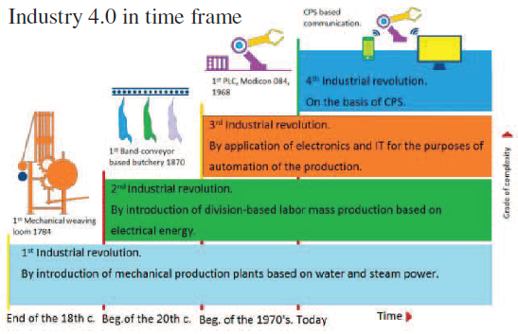
Future: Industry 4.0
Industry 4.0 is a strategic concept for future manufacturing including snart factory, value system for customer/partners, technical bulilding blocks (CPS) through IoT.
Basis for Industry 4.0 is smart objects (including sensors, intelligent control units, e.g. machines, plants or products, etc.) connecting together and exchanging information each other or with higher level platforms. These production units are called Cyber Physical System (CPS).
D.Lukac, “The fourth ICT-based Industrial Revolution -HMI and the case of CAE/CAD innovation with EPLAN P8”, 23rd Telecommunications forum (TELFOR) p.835, 2015.

Slide 32
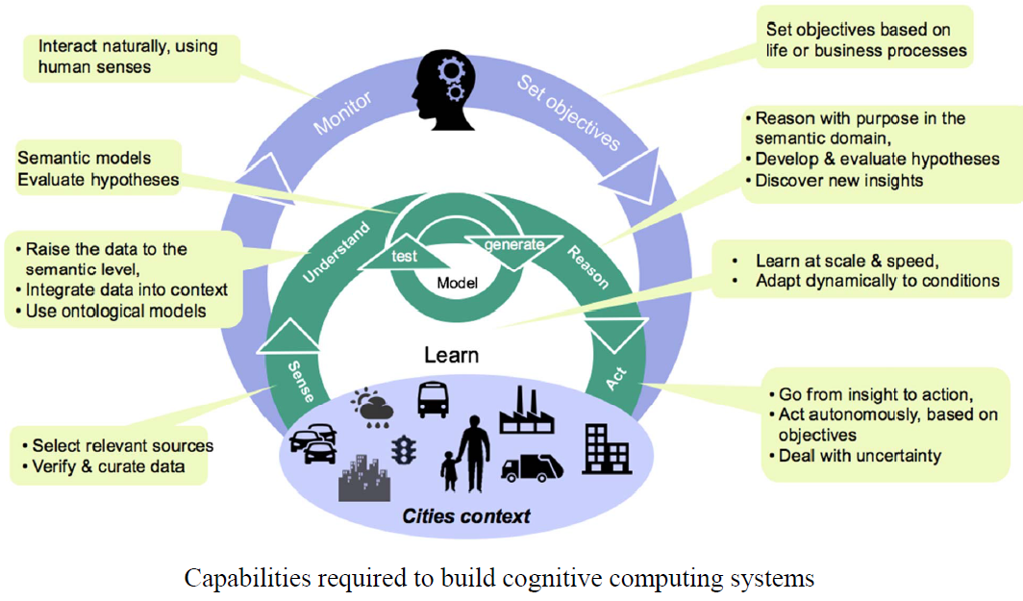
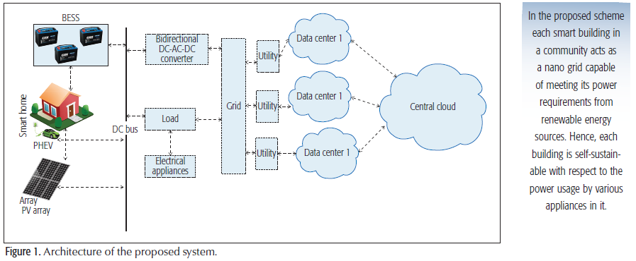
Future: Smart City/Home
Smart cities
Smart Buildings
(IBM) Martin G. Kienzle, “Cognitive Technologies for Smarter Cities”, 2016 IEEE 36th International Conference on Distributed Computing Systems (ICDCS), p.12, 2016.
Neeraj Kumar, et.al., “A Multi-Tenant Cloud-Based DC Nano Grid for Self-Sustained Smart Buildings in Smart Cities”, IEEE Communications Magazine, p.14, March 2017

Slide 33
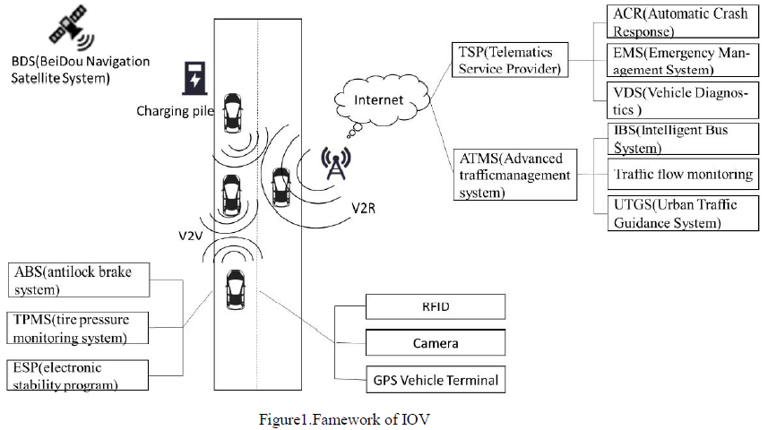
Future: Smart Car and Autonomous Driving
Jinfeng Wang, et.al., “Key technologies and development status of Internet of Vehicle”, 2017 9th Intl. Conf. on Measuring Technology and Mechatronics Automation, p.29, 2017..

Slide 34
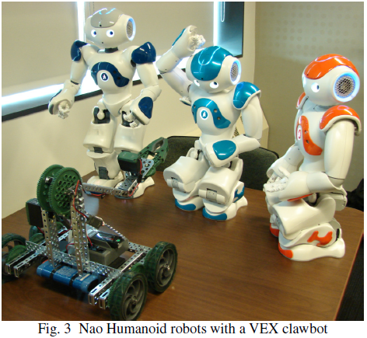
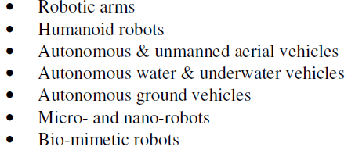
Future: Smart Robot
Rachid Manseur, “Robotics Engineering Program and Curriculum Development”, IEEE Frontiers in Education Conf (FIE) proceedings, p.1-5, 2014.

Slide 35
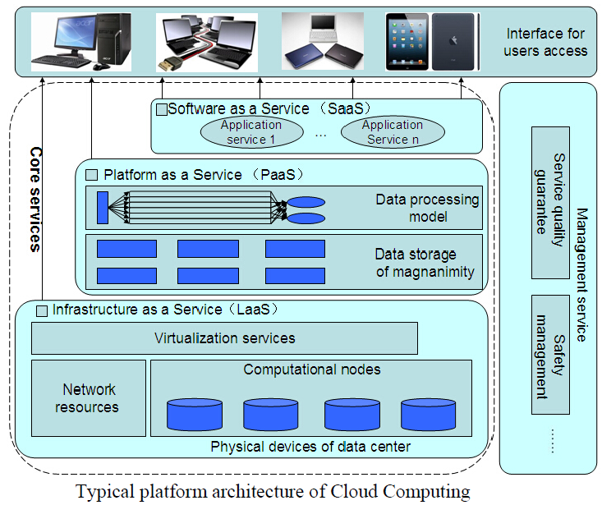
Future: Cloud and Big Data
L.F. Zeng, et.al.,”Cloud Computing and its Decision-making for Medical and Health Informatization in the Context of Big Data”, Intl Conf on bioinformatics and biomedicine, p.201, 2014.

Slide 36

Together We Win

