Slide 1
Huawei Corporate Presentation

Slide 2
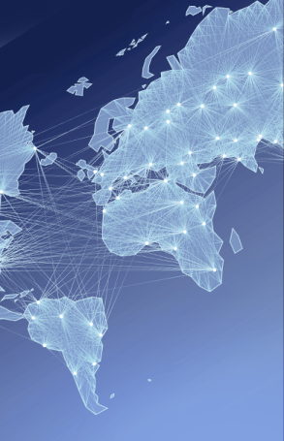
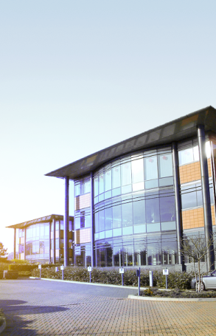
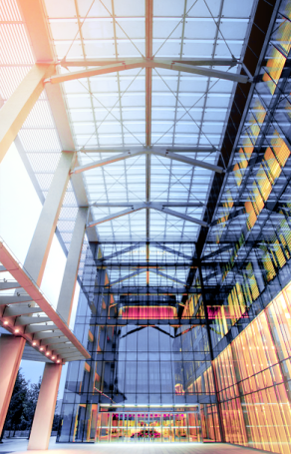
Huawei at a Glance
170+
129
176,000
79,000
36
16
Countries
Ranking in the Fortune Global 500
Employees
R&D employees
Joint innovation centers
R&D centers

Slide 3
2012–2016 business performance
Sales revenue
Operating profit
USD billion
XX
USD billion
7.3
XX
60.8
46.5
5.5
35.5
38.5
3.3
4.7
上半年
50
2012
2013
2014
2015
(unaudited)
2016
(unaudited)
2016
2012
2013
2014
2015

Slide 4
Long-term investment in innovation for technological breakthroughs
Keep investing XX%+ of annual revenue in R&D, making Huawei more competitive, pushing the industry forward, and driving technological advances.
10%
10%
USD Billion
XX.X
Over CNY240 billion invested in R&D over the past decade (2006–2015)
9.25
6. 61
5. 20
4. 77
Annual R&D investment for the future: US$10–20 billion
3.74
2. 67
2. 1
1.16
1.64
50,377 patents
A member of 300+ standards organizations, industry alliances, and open source communities; 280+ key positions in these organizations; 43,000+ proposals
2007
2008
2009
2010
2011
2012
2013
2014
2015
2016
(Unaudited)

Slide 5
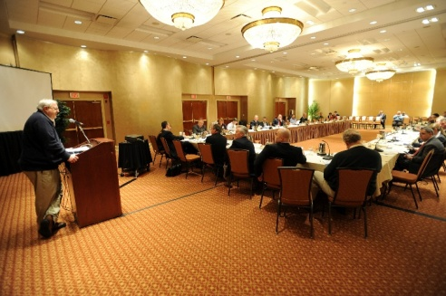
ICT is enabling a better, more efficient government
Public services
Public management
Public participation
Inclusive, efficient, and high-quality
Open, transparent,
responsible, and effective
Enhanced participation and greater trust

Slide 6
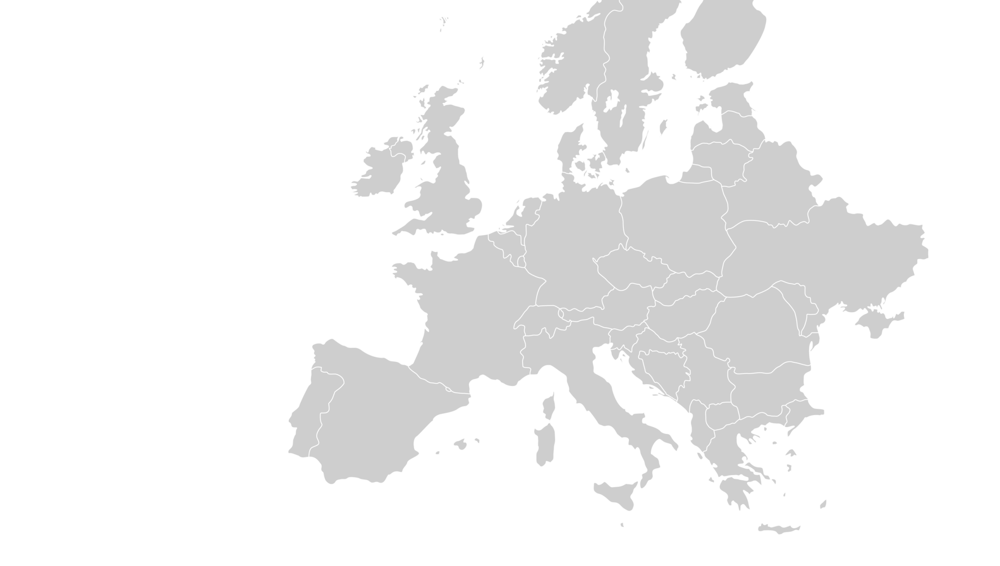
Huawei in Europe
customer training centers
technical assistance
centers
network O&M centers
7
2
6
2
logistics centers
2
EMS vendors
1
spare parts center
86
spare parts
warehouses
24
country-level warehouses

Slide 7
Huawei in Europe: A collaborative industry contributor
2 regional offices, 44 subsidiaries
10,000+ employees
1,600 R&D engineers
Local investment: US$4bn
Technical cooperation: EUR75m
Seeds for the Future program participants: 500+ top university students from 23 countries
Another 2,000 European university students are expected to go on study trips to China over the next five years
210 technical cooperation contracts; member of 8 EU-led "Horizon 2020" projects; partner of over 100 European universities and research institutes

Slide 8
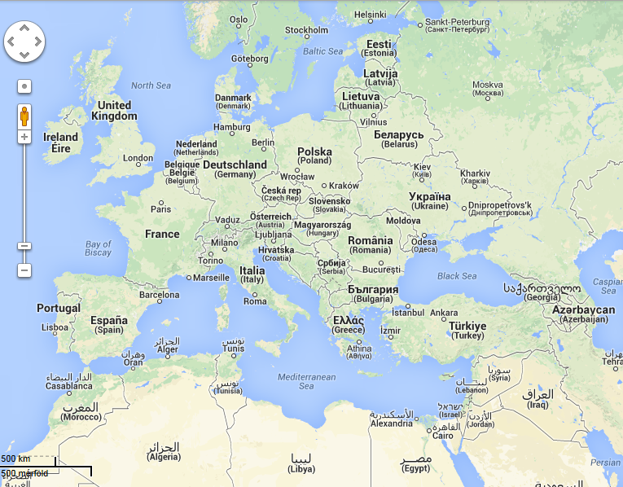
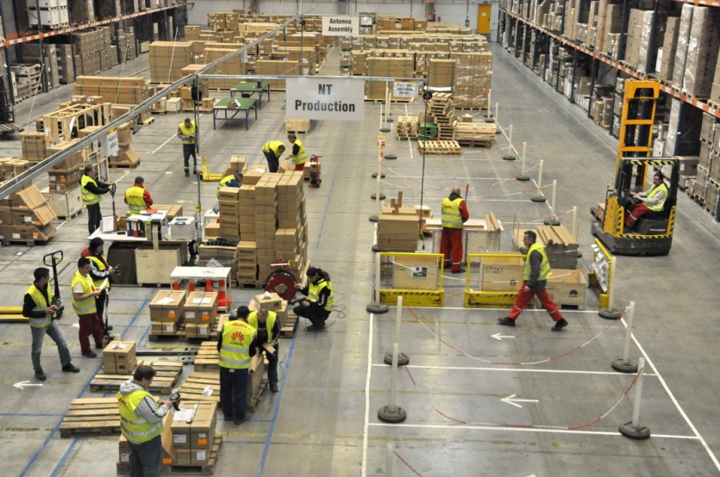
Huawei's European Logistics Center in Hungary
Serves 50 countries
Huawei's second largest global logistics center
Assembles and produces communications gear, such as wireless, access network, optical transmission, microwave transmission, servers, and storage products.
Major partners

Slide 9
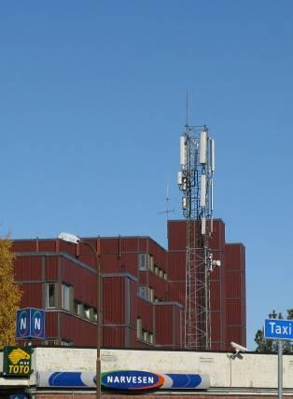
Helping European operators maintain their leadership
Huawei has worked closely with European operators during the end-to-end process and commercialized its new products first in Europe, driving Europe's development of cutting-edge technologies.
In 2004, Huawei launched the industry’s first distributed base station and firstly deployed it in Europe.
In December 2009, Huawei deployed the world's first LTE network for TeliaSonera.
In October 2010, many operators in Sweden and Austria were the first to commercially use Huawei's industry leading E398 data card that supports LTE, 3G, and 2G.
In May 2011, Huawei deployed the world's first LTE DD800 network using the SingleRAN LTE solution for Vodafone.
In September 2011, Huawei deployed the world's first LTE TDD/FDD FMC network for Polish operator Aero2.
In October 2012, Huawei launched the world's first second-generation E-band microwave solution which was first commercially deployed in Europe.
In October 2013, Huawei and BT successfully launched the world's first G.fast trial, bringing copper access into the Gigaband era.
In November 2014, the University of Surrey unveiled the world's first 5G testbed at its 5G Innovation Centre (5GIC). As a founding member of 5GIC, Huawei played a key role.
TeliaSonera's LTE base station

Slide 10
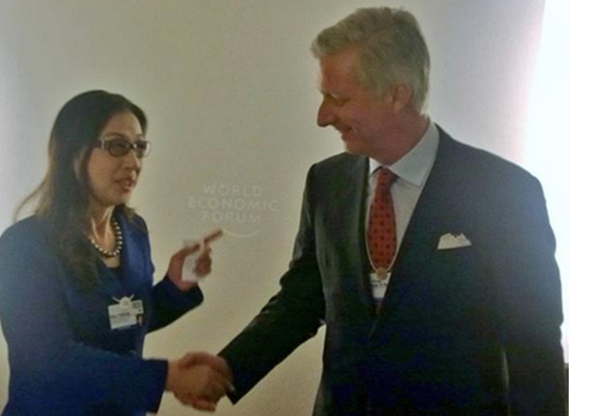
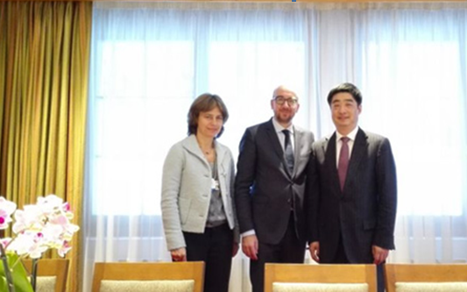
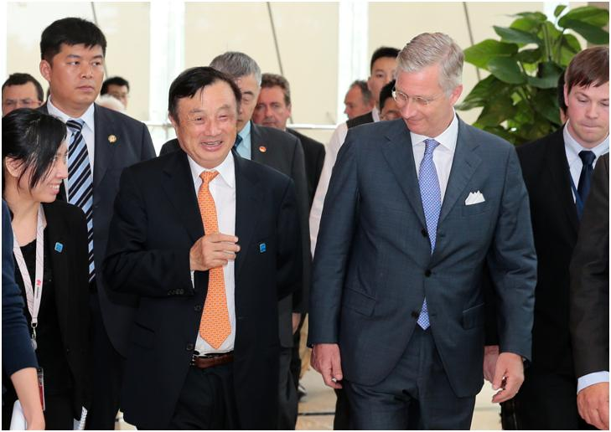
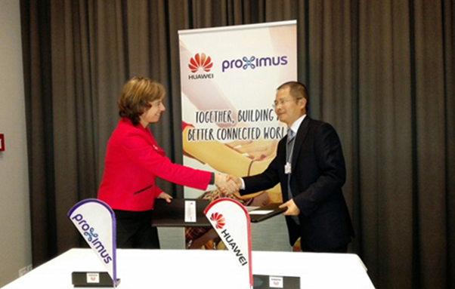
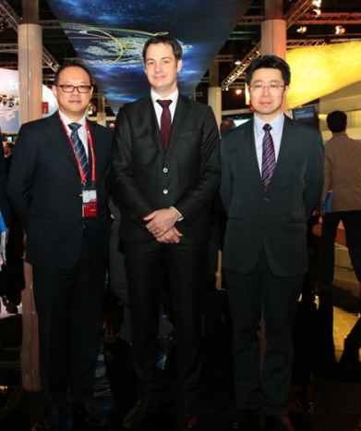
Huawei in Belgium
22nd Jan 2015, the King Mr. Philippe met Huawei Madam Sun
22nd Jan 2015, PM Mr. Charles Michel met Huawei Mr. Huhoukun
27th Jun 2015, the King Mr. Philippe met Huawei Ren Zhengfei
21st Jan 2015, Proximus and Huawei announced the establishment of strategic cooperative partnership
4th Mar 2015, Deputy PM Mr. Alexander De Croo discussed the ICT development and innovation

Slide 11
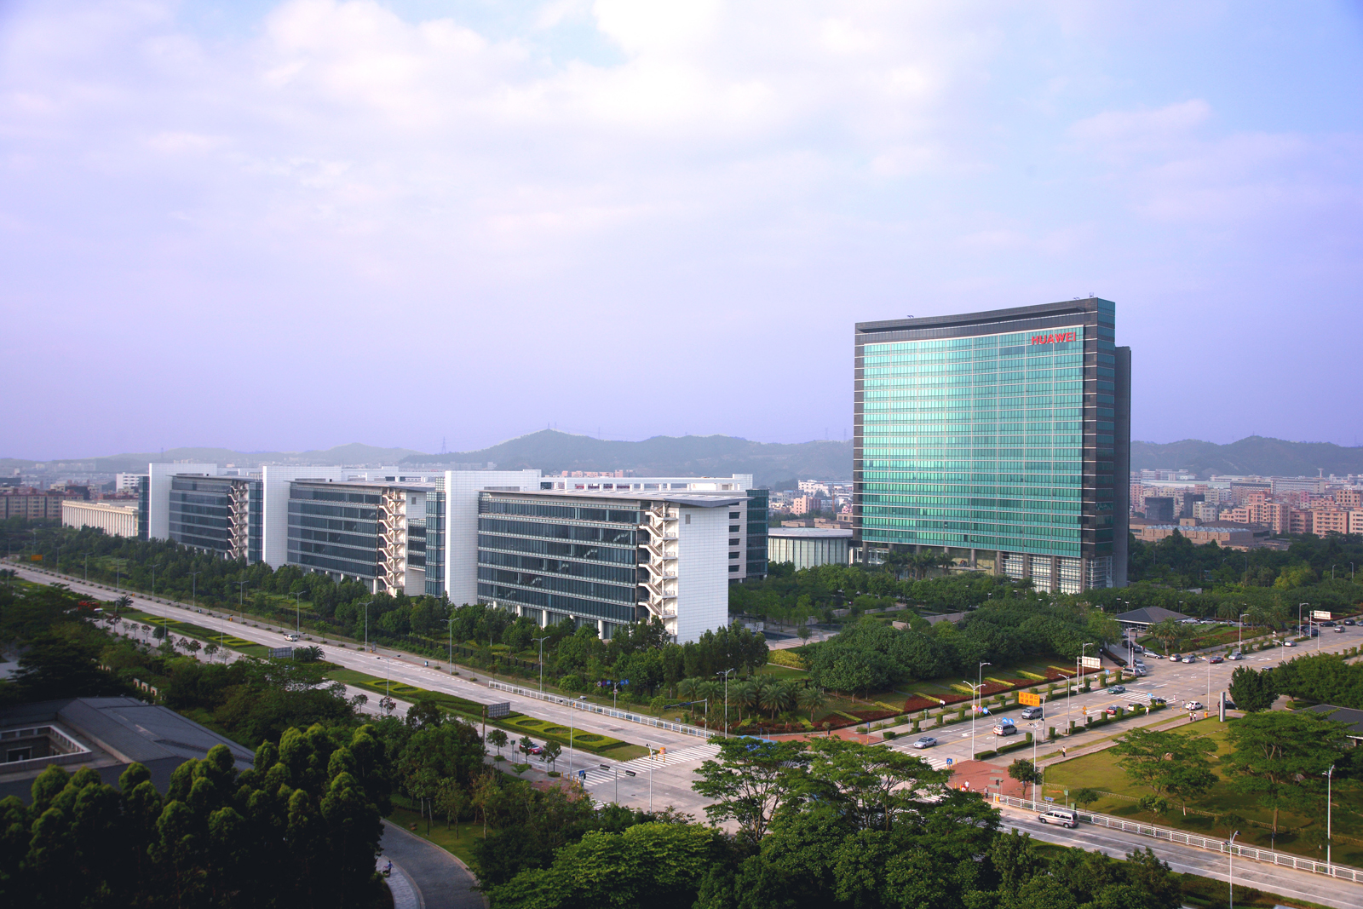
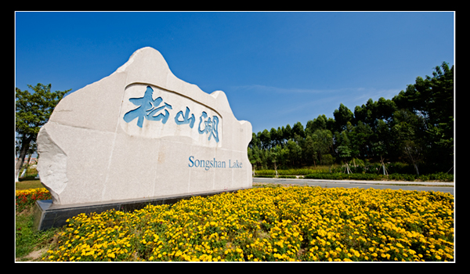
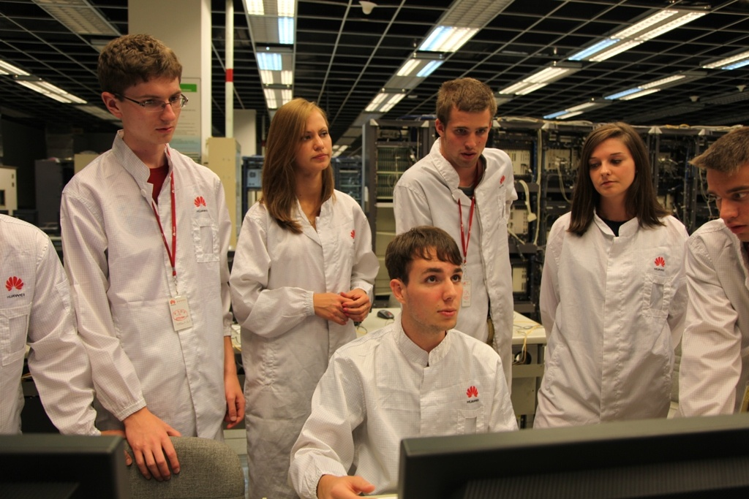
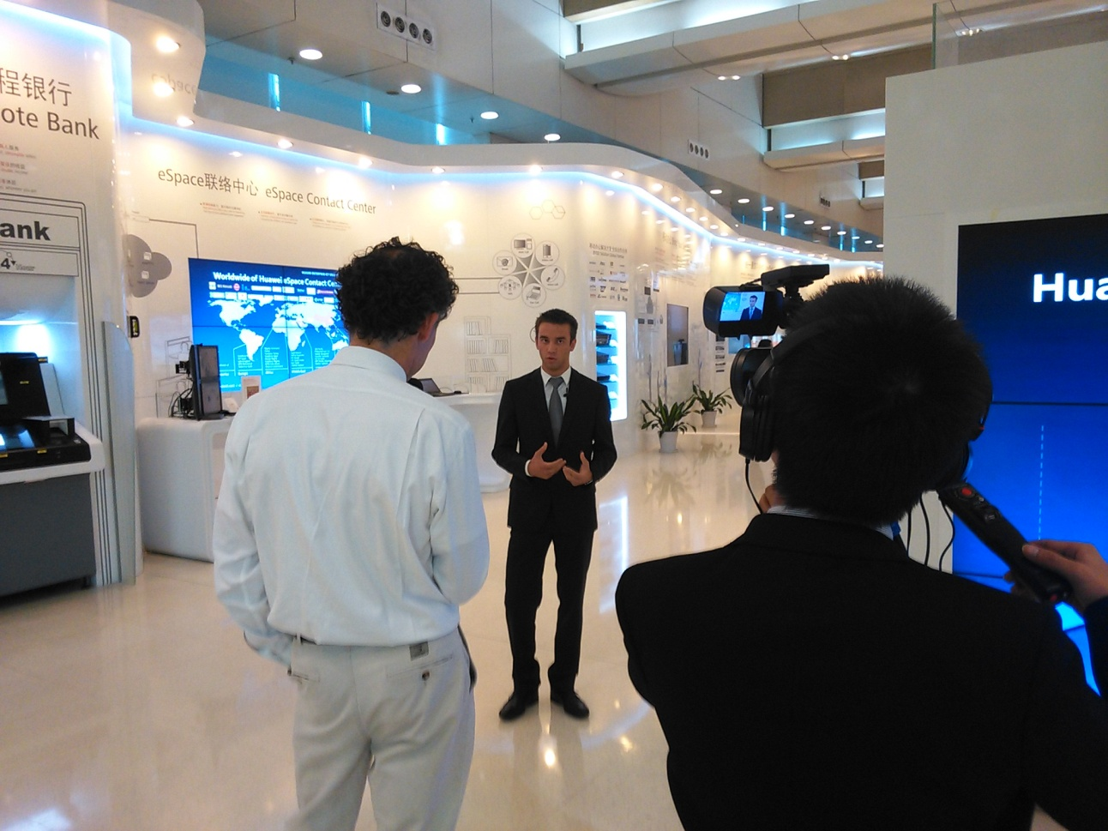
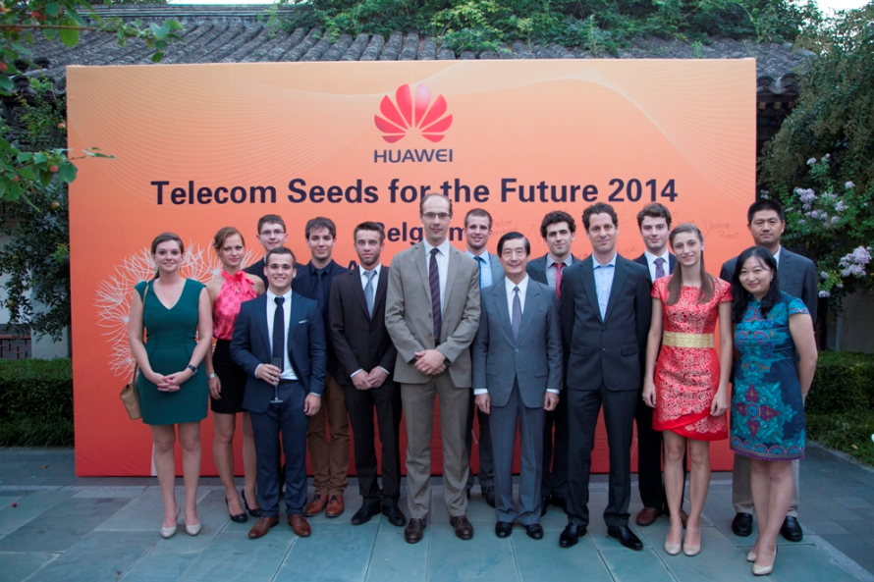
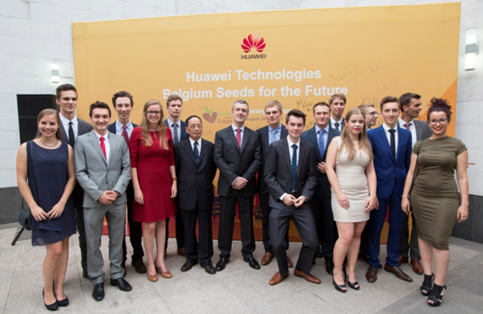
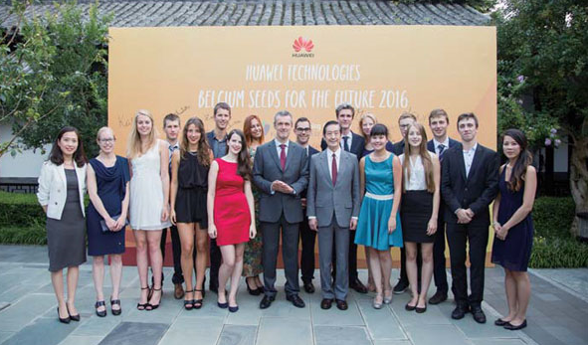
“ICT Seeds For the Future” in Belgium
Huawei promotes the development of ICT education in Europe and strengthening the global experience of youth.
“ICT seeds for the future” program sends young people to China and training in digital education and ICT skills.
2014
2015
2016

Slide 12
Thank you !
Copyright©2014 Huawei Technologies Co., Ltd. All Rights Reserved.
The information in this document may contain predictive statements including, without limitation, statements regarding the future financial and operating results, future product portfolio, new technology, etc. There are a number of factors that could cause actual results and developments to differ materially from those expressed or implied in the predictive statements. Therefore, such information is provided for reference purpose only and constitutes neither an offer nor an acceptance. Huawei may change the information at any time without notice.

