Slide 1


Factories of the Future in Wallonia
Benoit Macq
DigitalWallonia.be
UCL-Louvain-la-Neuve

Slide 2
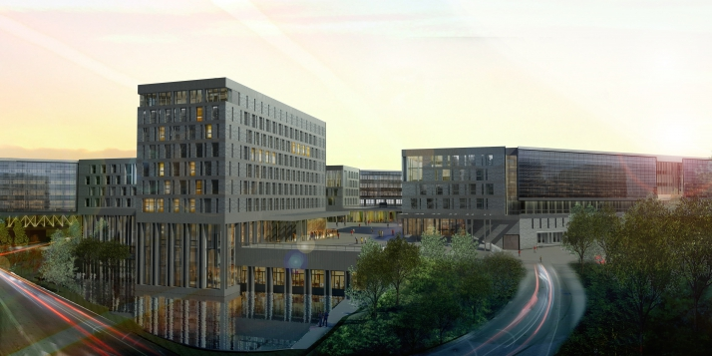
Wallonia, Louvain-la-Neuve, CBTC,
University-Industry innovative ecosystem

Slide 3
The Digital Agenda of the Region
Digital
transformation
of the economy
The digital
economy
Digital Wallonia
DW-Hub
Creative Economy
Digital start-up fund
ICT in Horizon 2020
Talents for the future
Big data platform
e-commerce
Smart-factories
Public Sector
e-health
e-gov
Smart-cities

Slide 4
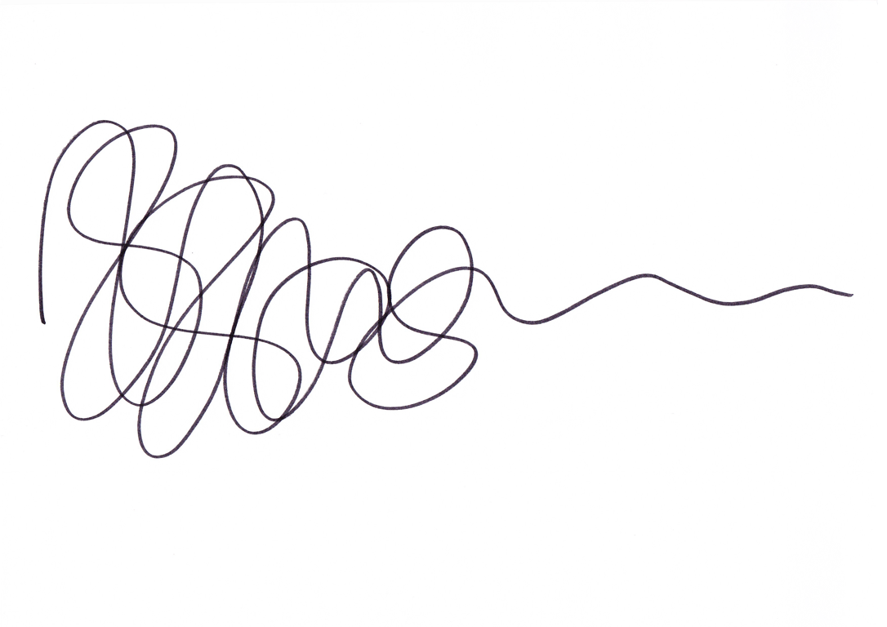


Wallonia: Innovation Attitude : creative wallonia
Uncertainty
Clarity / Focus
Research &
understand
Design new
Models and prototypes
Implement business
model design
Source: Damien Newman

Slide 7
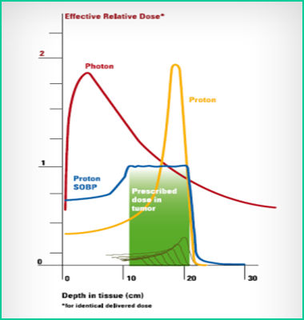
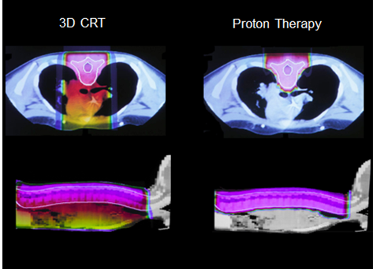
Example 1: protontherapy systems by IBA: IBA 4.0 (1)

Slide 8

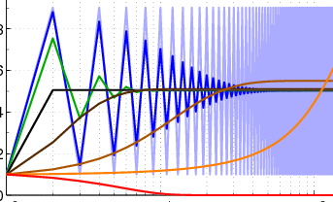
IBA 4.0 (2): Cyberphysics for the beam
Monitor chambers
Scanning magnets
QA/Dosi
Detectors
Line magnets
Beamline
Equipment settings
Beam diagnostics
Machine learning
techniques
Convergence
Algorithms

Slide 9
IBA 4.0 (3): big data for the maintenance
Expose resulting conclusions
to the user
Learning Machine
Statistical Analysis
Predictive model
Decision Management
Pattern Recognition
Process data
towards elaborated analysis
Format data
towards intelligent storage
Extract primary data
from system components

Slide 10
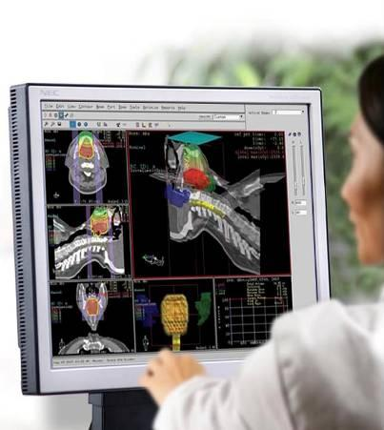
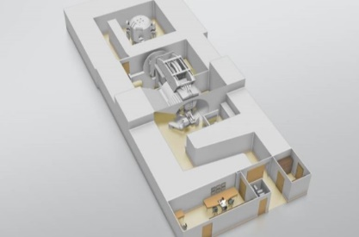
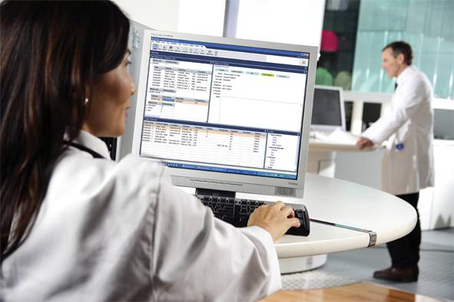
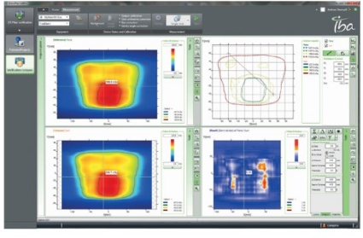
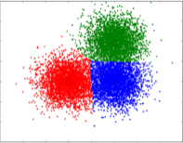

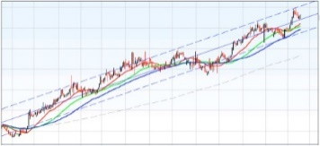
IBA 4.0 (4): deep learning for personalized treatment
Proton Therapy
System
Treatment Planning
System
Oncology Information
System
Dosi / QA
System
System
Logs
Treatment plans
Patient data
Ops Schedule
QA reports and trends
Digital Phantoms
Personalized clinical workflows
Improved schedules
Timely QA procedures
Clustering
Patterning
Trending

Slide 11
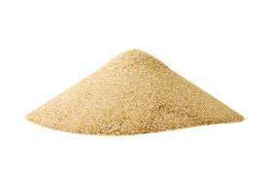
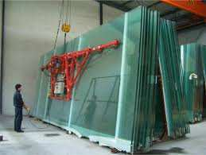
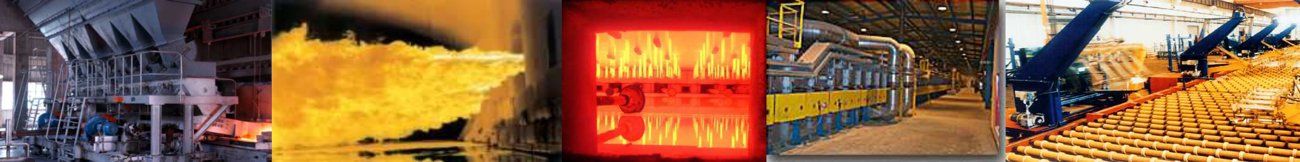
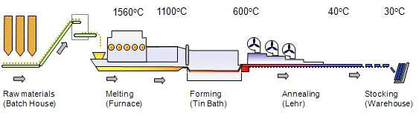
Example 2: The float process From sand to glass : AGC 4.0 (1)
500 m
Consumption
1 hour furnace in operation ~ 2 y of domestic boiler consumption 1 float furnace ~ 20 000 domestic boilers
up to 15-20 years
Time life

Slide 12



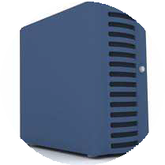
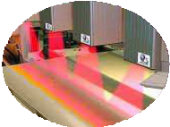
A numerical process strategy in 4 axis, AGC 4.0 (2)
PILOT
Data driven decision tool
UNDERSTAND
Data digestion by specific algorithm
ORGANIZE
Data efficiently stored on numeric support
LISTEN
Data is collected from the process (sensors, observation,…)

Slide 13
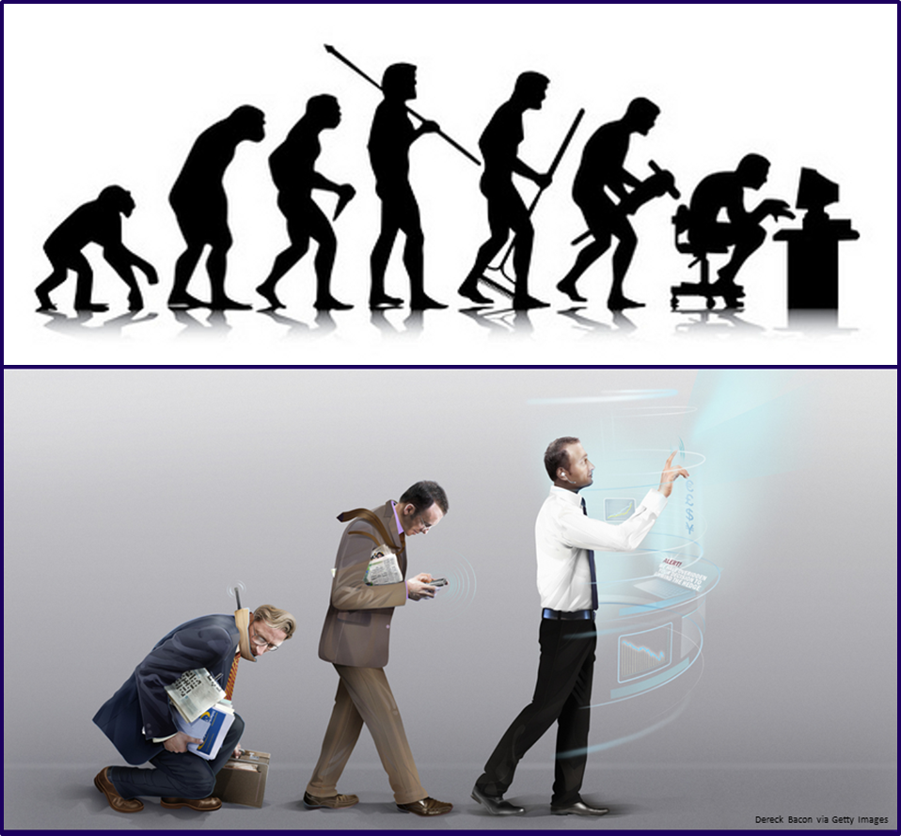
Example 3: Augmented operators in the production line
Leading edges:
Task Modeling (UsiXML)
Multimodal interactions
UX-Agile design

