Slide 1
(How) do visitors read our Museumtexts?
Reinoud Magosse, Dimitri Woussen and Joelle Karnas
The visitors Observatory of the Federal Scientific Institutions of Belgium
Ecsite Conference Gothenburg, 7 june 2013

Slide 2
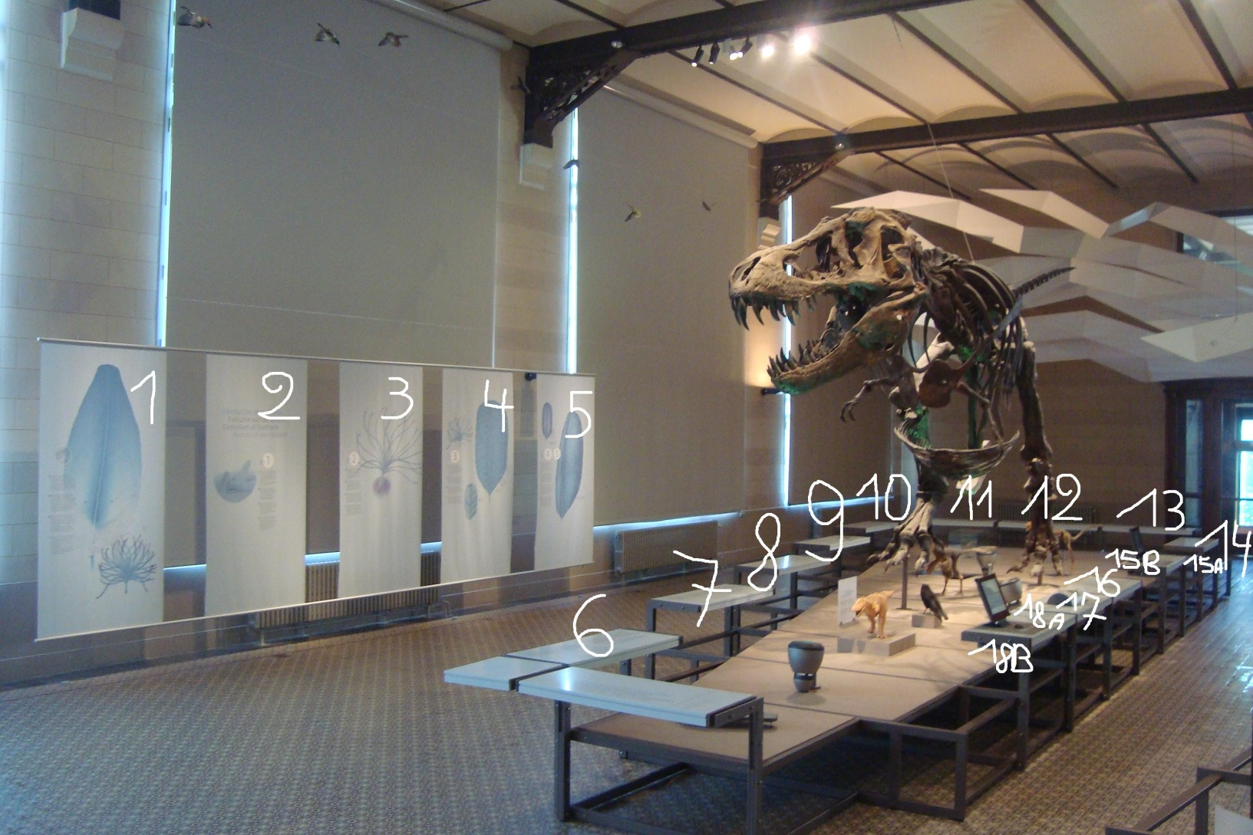
What we did?

Slide 3
Individu n° : Date Interrogé : Oui / Non
Texte :
Lu :
Individu : H/F :
B/E/Ado/A/S :
Caractéristique spéciale :
Type d’interaction :
Participant à l’interaction :
Groupe :
Type de groupe :
Texte Général (texte) Détails Général
Légende :
Texte : 1 => 18
11, 12, => sans texte
Lu : Oui, non, +/-
Individu : H = Homme F = Femme
S = Senior A = Adulte Ado = Adolescent E = Enfant B = Bébé
Interaction : M = Montrer, R = Raconter (après avoir lu), E = Expliquer, D = Discuter.
Exemple : EA = Explication adulte EE = Explication enfant ME = Montrer par enfant ..
Participant à l’interaction : Senior / Adulte / Ado / Enfant / Tout le groupe.
Caractéristique spéciale : R = fauteuil roulant / H = handicap / A = autre

Slide 4
Main findings
Visitors do read Museum texts: 4 people on 5
The reading is very fragmented: 2 text on average
The reading is clustered: neighboring texts
In general texts have a high holding power: drop out =8%
Texts have a relatively higher holding power than the video fragments
A hierarchy of push- and pull factors seems to exist:
  1. Location (vis-à-vis the object)
  2. format/ presentation: Regular texts have a higher attracting power than images and video fragments!
  3. Title style: interrogative titles have the highest attracting power

Slide 5
Main findings
In 1 case out of 4, the actions of other visitors prevented the respondents to read a certain text or series of texts: visiting a museum remains a very social experience
High general comprehension per text: 5 minutes later, 86% is able to reformulate in its own words.
Relatively lower detailed comprehension per text: 5 minutes later, 76% remembers the small details.
Most visitors didn’t get “the message” or “the big idea”: 11%
Texts incite for (Social) Interaction: in 50% of the cases
Texts incite for discussion: 67% discussing, 25% explaining, 8 % pointing
The adult as mediator and expert: almost 2/3 of interactions take place between children and adults (50 adults, 12% seniors). 19 % between adults, 8% among teenagers

Slide 6
Thanks for your attention!
Please visit us on
http://www.belspo.be/belspo/pubobs/index_en.stm

Slide 7
Attachments

Slide 8
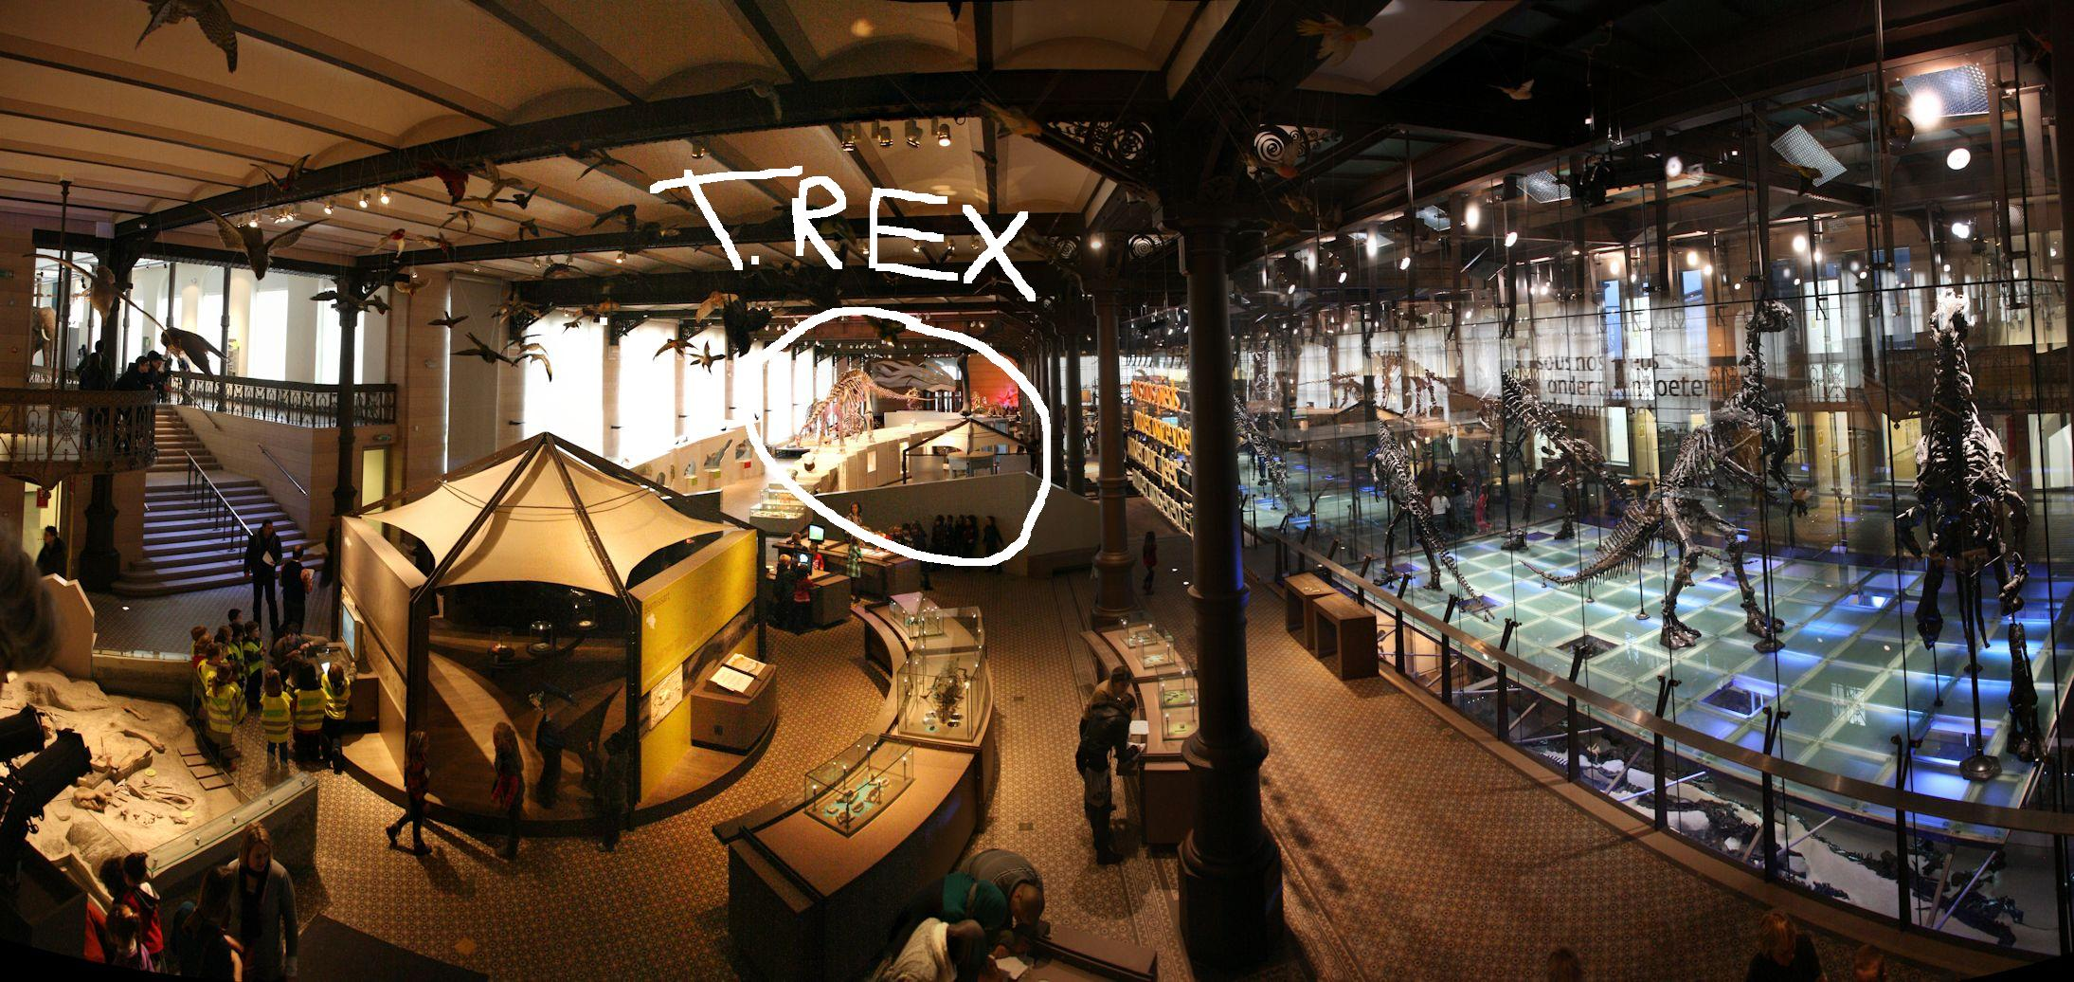
Overview of the dinosaurhall

Slide 9
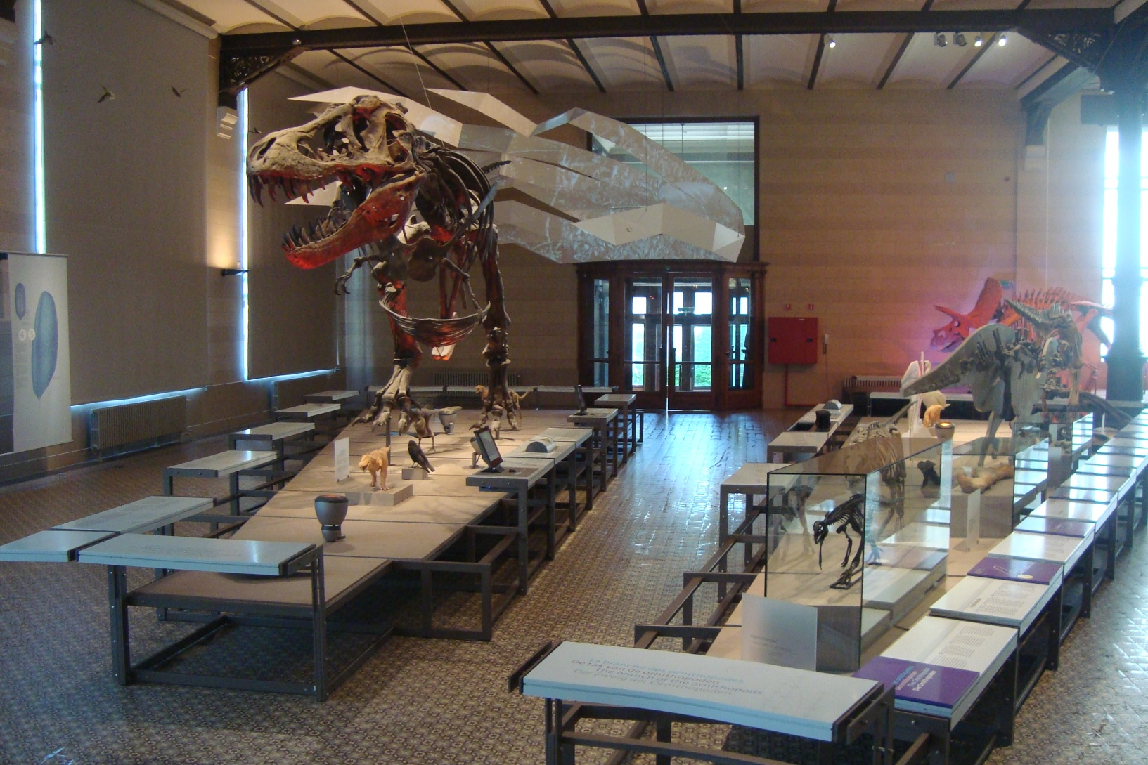
T. Rex exhibit and nearby exhibit on ornithopods

Slide 10
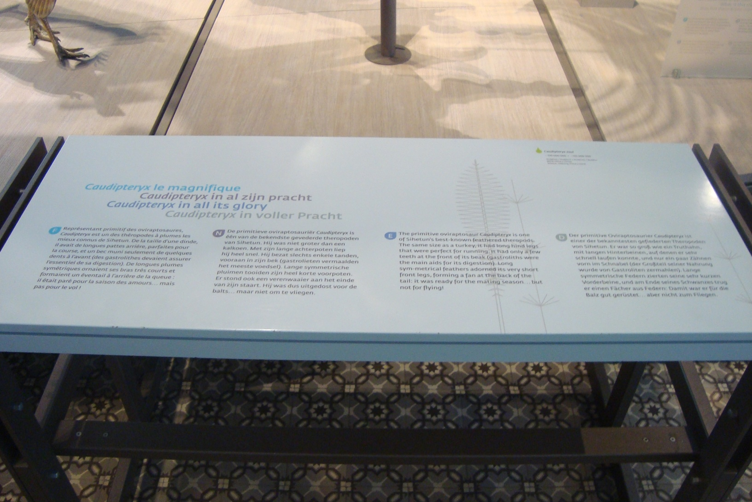
Detail horizontal text support

Slide 11
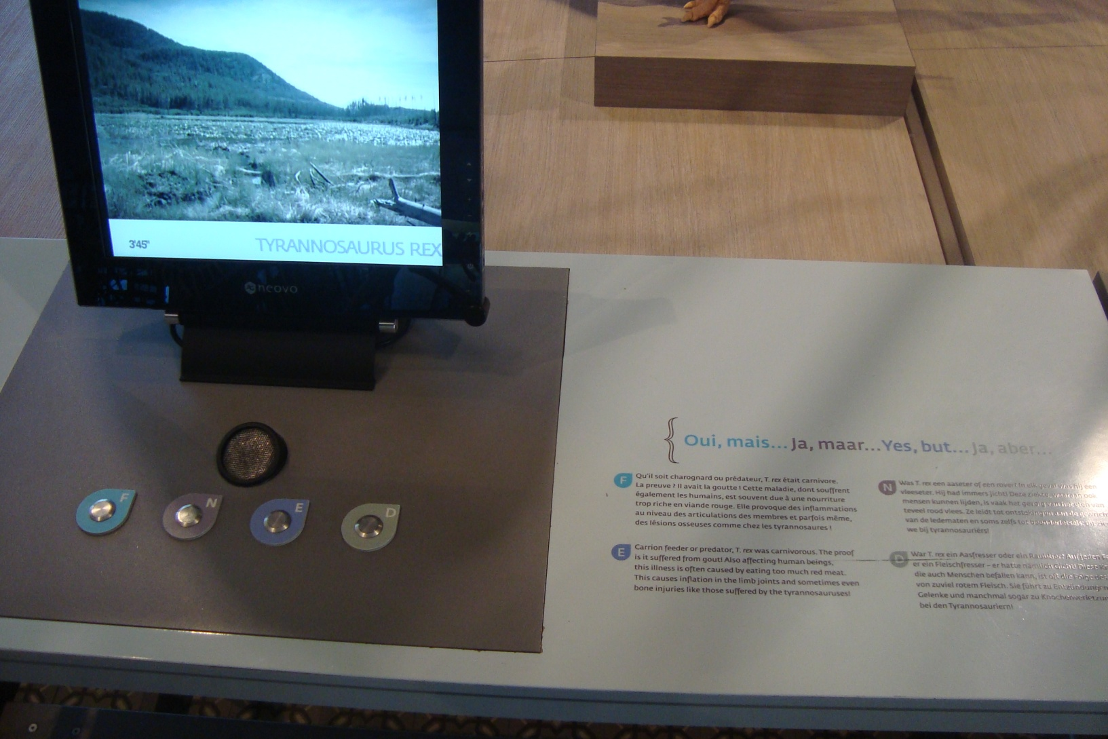
Detail videofragment and intro text

Slide 12
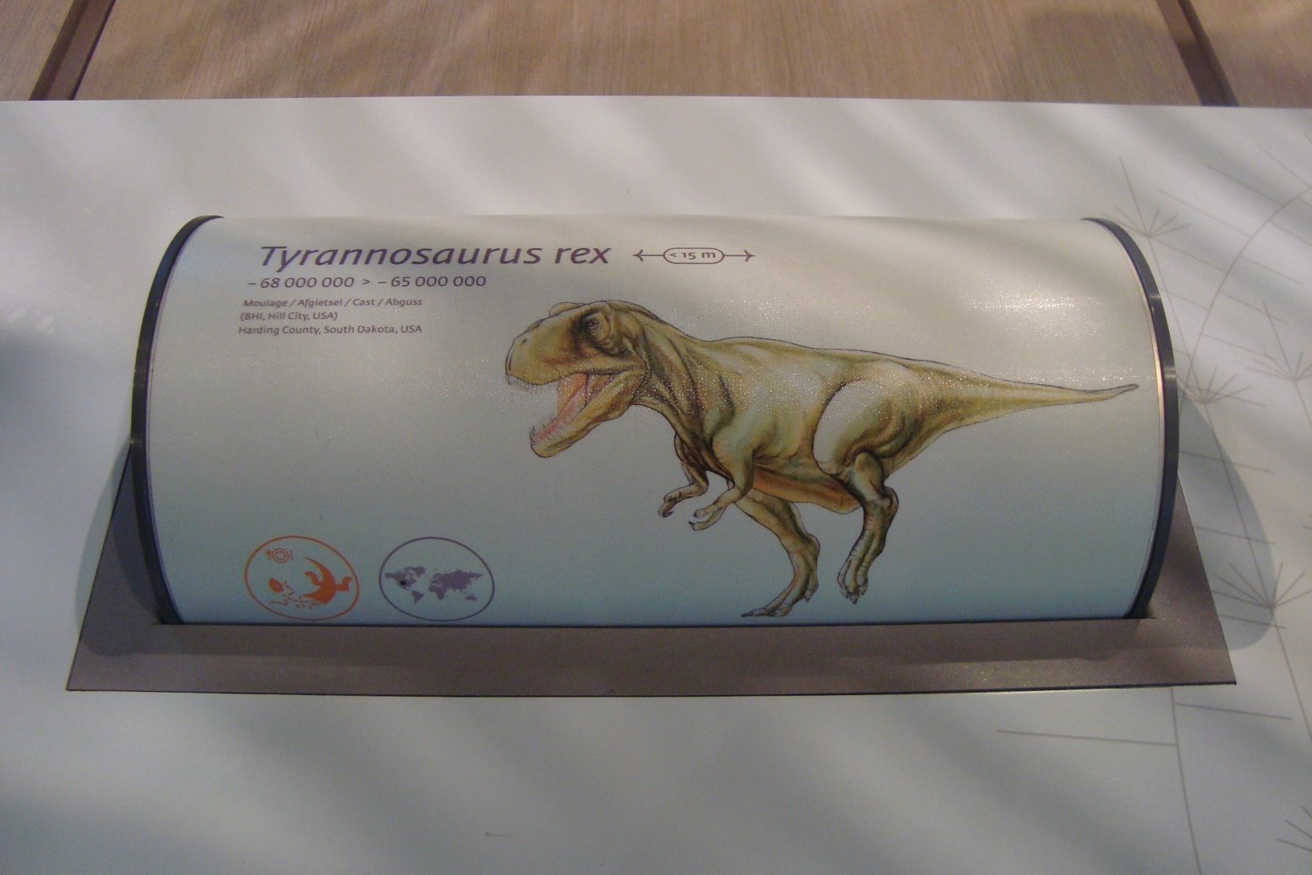
Detail T. rex “roll”

Slide 13
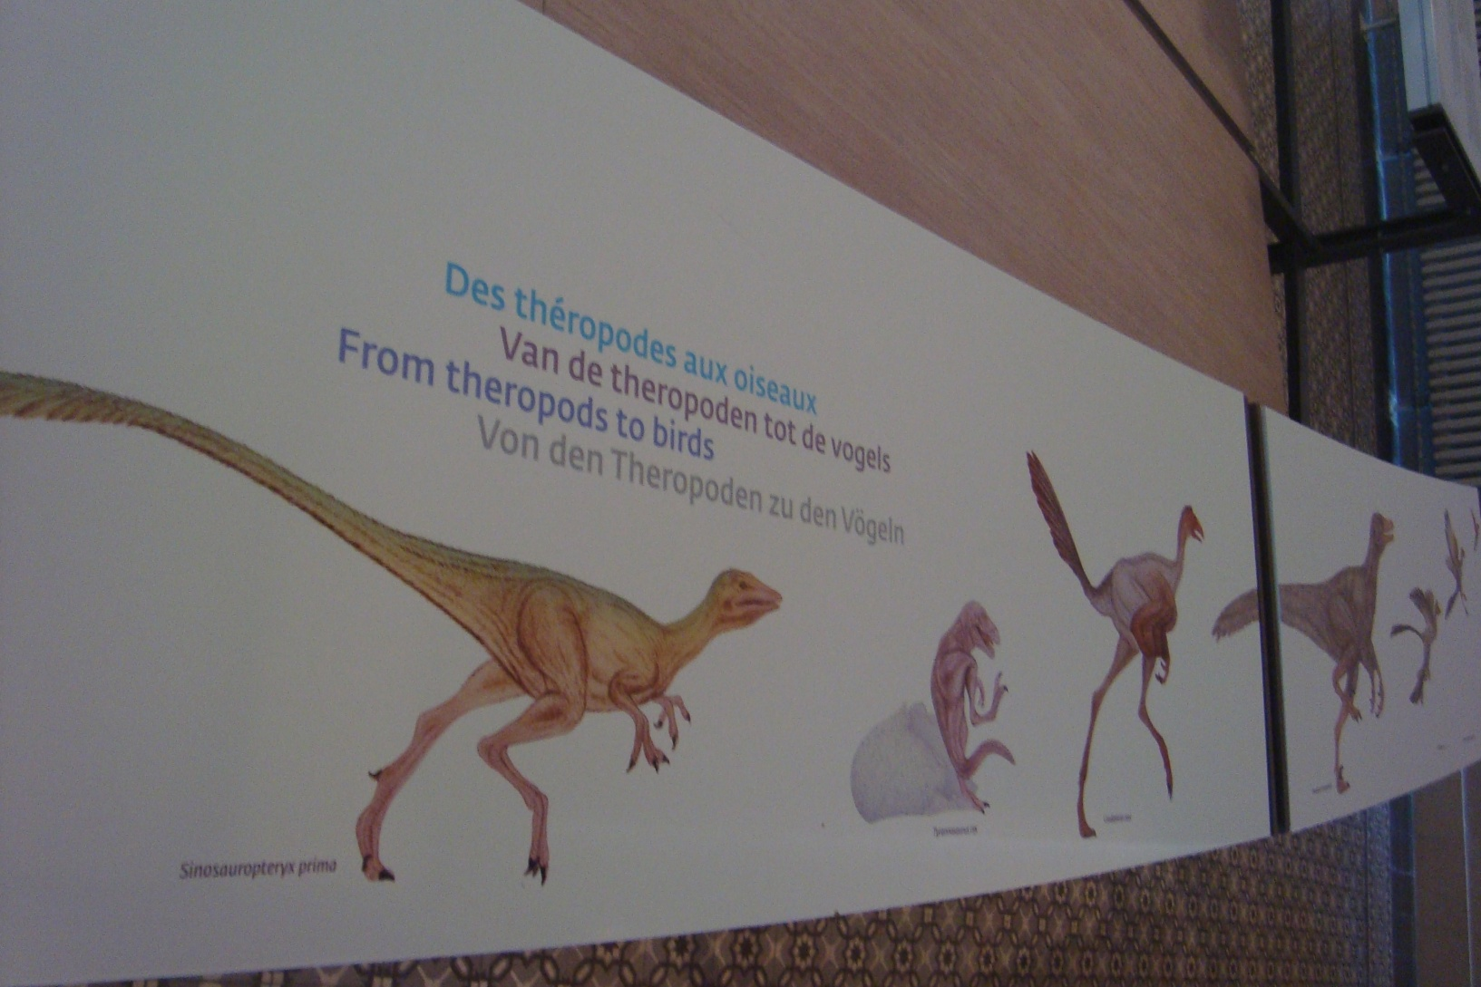
Detail drawings 11 & 12

