Slide 1
Emissions de CO₂ et objectifs climatiques
Pierre Friedlingstein
University of Exeter, UK
Plus many IPCC WG1 authors and GCP colleagues

Slide 2
Recent trends in anthropogenic CO₂ emissions

Slide 3
Fossil Fuel and Cement Emissions

Slide 4
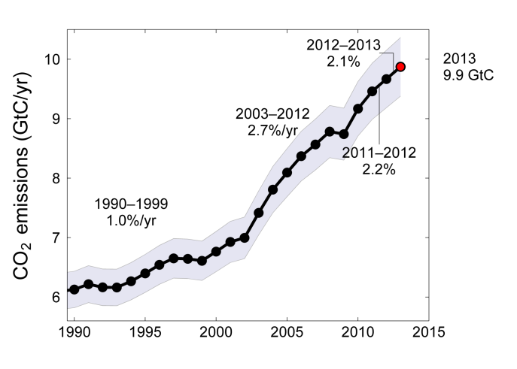
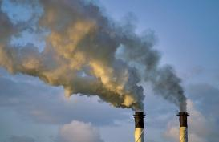
Fossil Fuel and Cement Emissions
Global fossil fuel and cement emissions: 9.7 ± 0.5 GtC in 2012
Projection for 2013 : 9.9 ± 0.5 GtC, 61% over 1990
2003-2012 average: 8.6 ± 0.4 GtC
Uncertainty is ±5% for one standard deviation (IPCC “likely” range)
Source: Le Quéré et al 2013; CDIAC Data; Global Carbon Project 2013

Slide 5
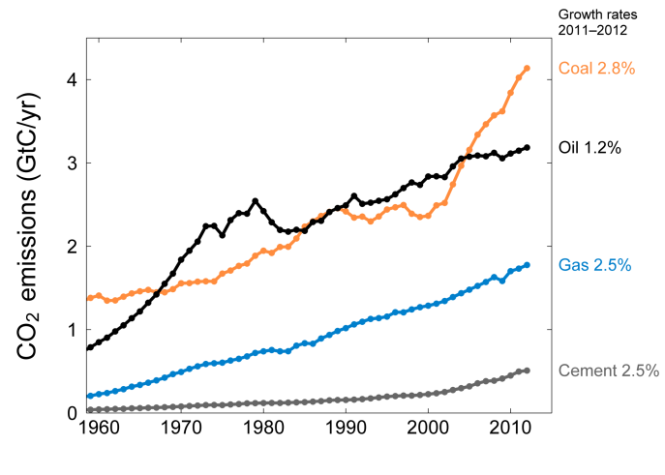
Emissions from Coal, Oil, Gas, Cement
Share of global emissions in 2012:
coal (43%), oil (33%), gas (18%), cement (5%), flaring (1%, not shown)
Source: CDIAC Data; Le Quéré et al 2013; Global Carbon Project 2013

Slide 6
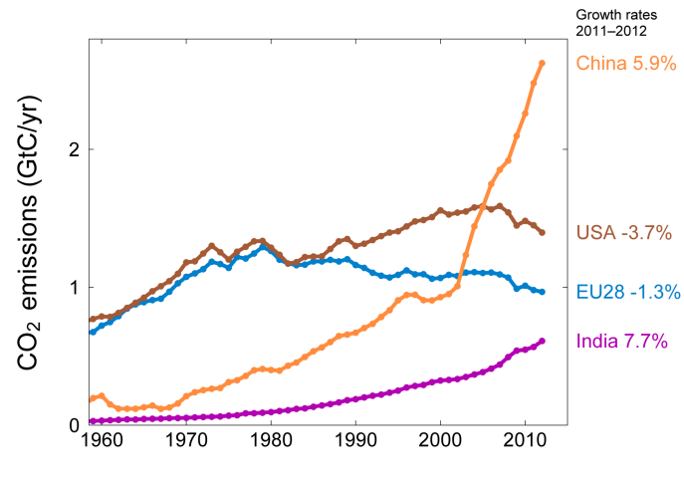
Top Fossil Fuel Emitters (Absolute)
Top four emitters in 2012 covered 58% of global emissions
China (27%), United States (14%), EU28 (10%), India (6%)
Source: CDIAC Data; Le Quéré et al 2013; Global Carbon Project 2013

Slide 7
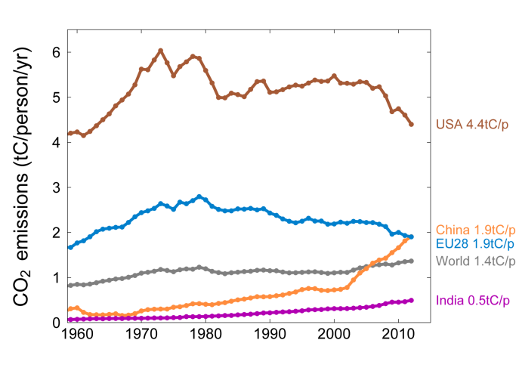
Top Fossil Fuel Emitters (Per Capita)
Average per capita emissions in 2012
China is growing rapidly and the US is declining fast
Source: CDIAC Data; Le Quéré et al 2013; Global Carbon Project 2013

Slide 8
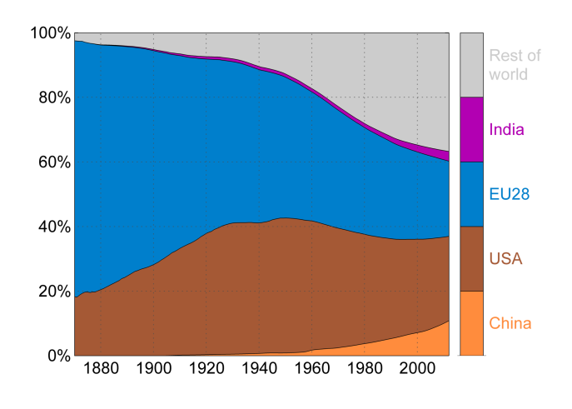
Historical Cumulative Emissions by Country
Cumulative emissions from fossil-fuel and cement were distributed (1870–2012):
USA (26%), EU28 (23%), China (11%), and India (4%) covering 64% of the total share
N° 1
N° 1
Cumulative emissions (1990–2012) were distributed USA (20%), China (18%), EU28 (15%), India (5%)
Source: CDIAC Data; Le Quéré et al 2013; Global Carbon Project 2013

Slide 9
Land-Use Change Emissions

Slide 10
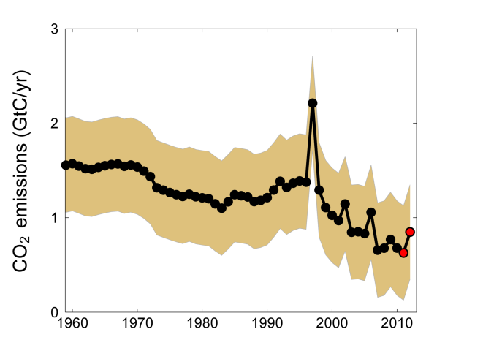
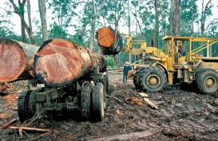
Land-Use Change Emissions
Global land-use change emissions are estimated 0.8 ± 0.5 GtC during 2003–2012
The data suggests a general decrease in emissions since 1990
Indonesian peat fires
2011 and 2012 are extrapolated estimates
Source: Le Quéré et al 2013; Houghton & Hackler (in review); Global Carbon Project 2013

Slide 11
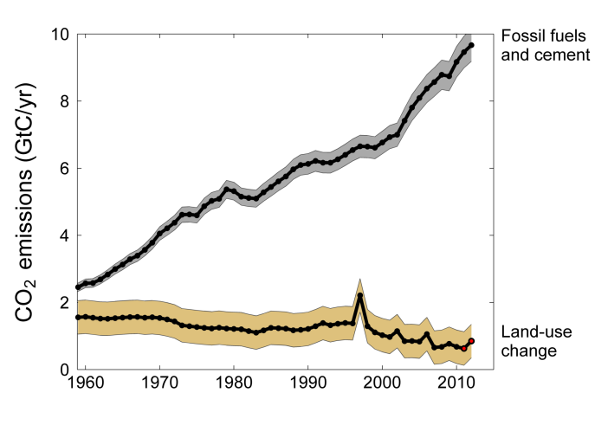
Total Global Emissions
Total global emissions: 10.5 ± 0.7 GtC in 2012, 43% over 1990
Percentage land-use change: 38% in 1960, 17% in 1990, 8% in 2012
Land use emissions in 2011 and 2012 are extrapolated estimates
Source: Le Quéré et al 2013; CDIAC Data; Houghton & Hackler (in review); Global Carbon Project 2013

Slide 12
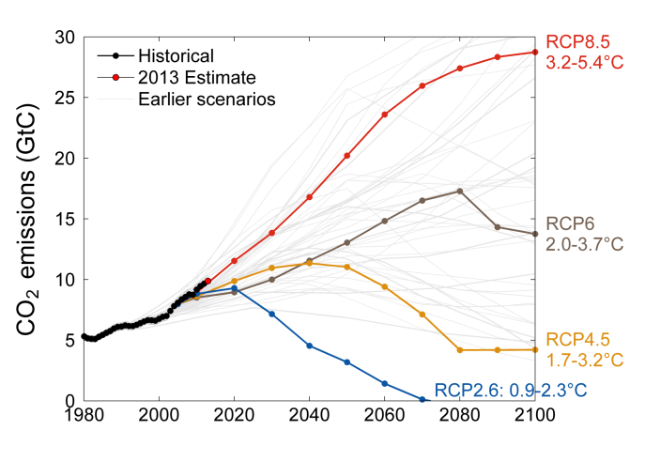
Observed Emissions and Emissions Scenarios
Emissions are on track for 3.2–5.4ºC “likely” increase in temperature above pre-industrial
Large and sustained mitigation is required to keep warming below 2ºC
Linear interpolation is used between individual data points
Source: Peters et al. 2012a; CDIAC Data; Global Carbon Project 2013

Slide 13
Cumulated CO₂ emissions and the 2°C target

Slide 14
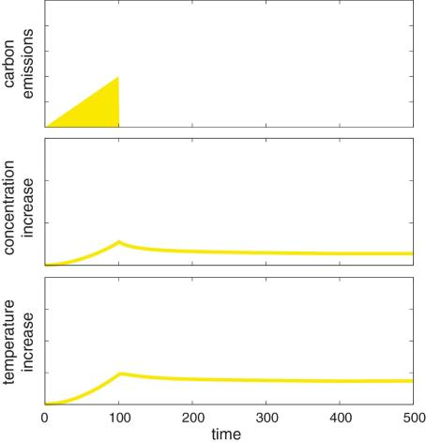
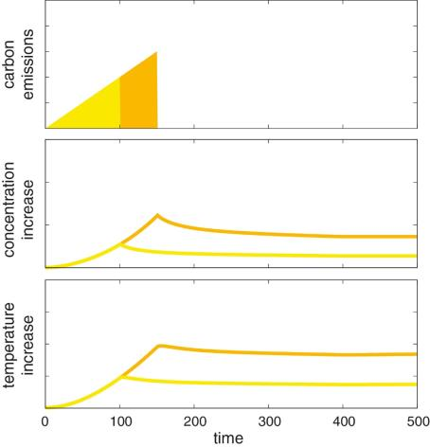
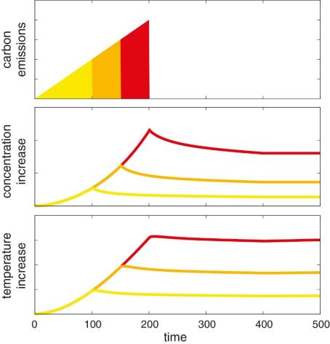
Warming will persist for centuries
Zero CO₂ emissions lead to near constant surface temperature.
A large fraction of climate change persists for many centuries.
Depending on the scenario, about 15-40% of the emitted carbon remains in the atmosphere for 1000 yrs.

Slide 15
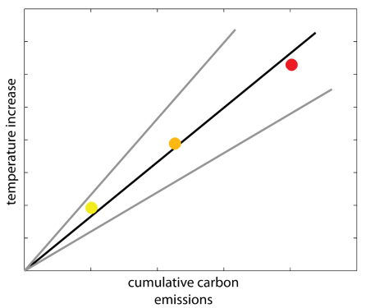
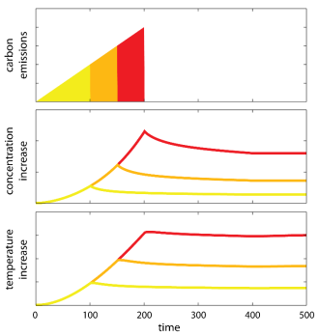
Cumulative carbon determines warming
Peak warming is approximately proportional to cumulative (total) emissions.
Transient climate response to cumulative carbon emissions TCRE = Warming per 1000 PgC

Slide 16
Trajectory does not really matter
RCP2.6
Warming is approximately proportional to cumulative emissions.
More emissions sooner means less emissions later

Slide 17
Transient Climate Response to cumulative carbon emissions (TCRE)
Estimated from many independent studies

Slide 18
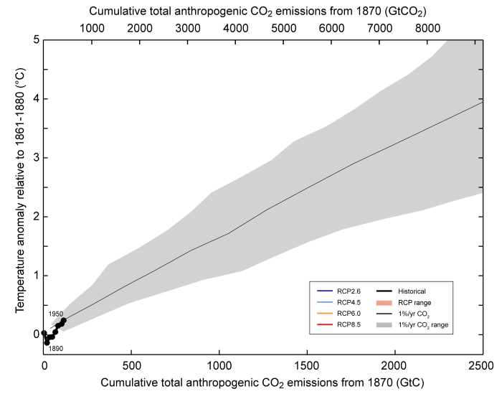
TCRE best estimate is 0.8-2.5ºC warming for 1000 GtC emission
Assessed likely range
0.8-2.5°C

Slide 19
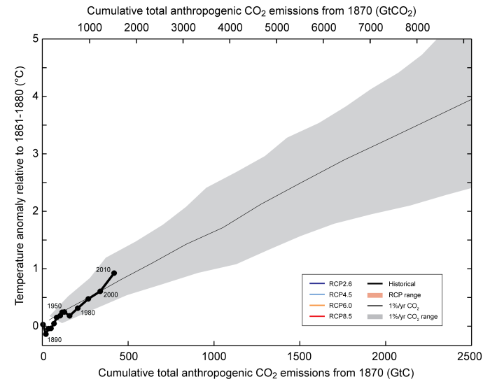
Warming caused by cumulative carbon emissions to 2010

Slide 20
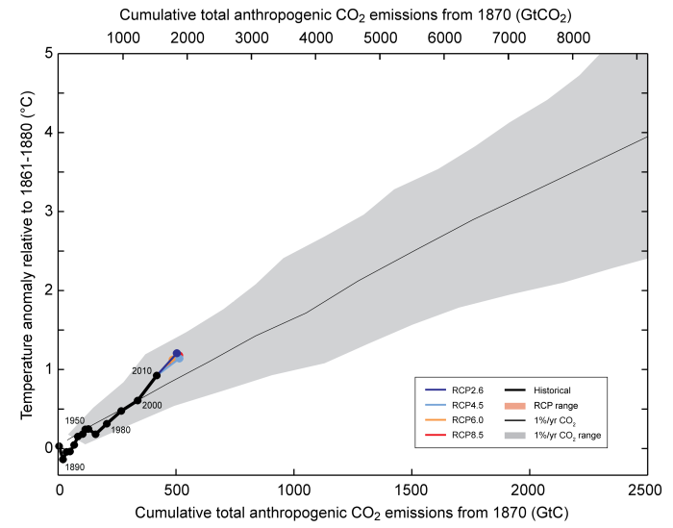
Warming caused by cumulative carbon emissions to 2020

Slide 21
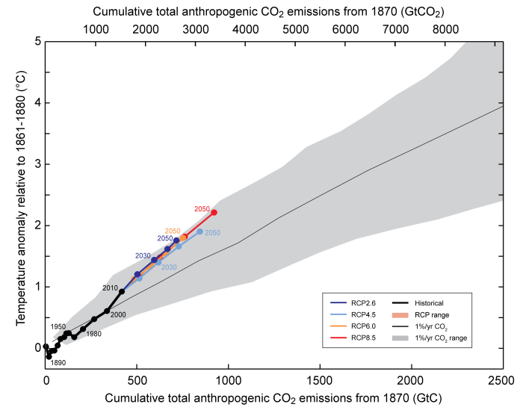
Warming caused by cumulative carbon emissions to 2050

Slide 22
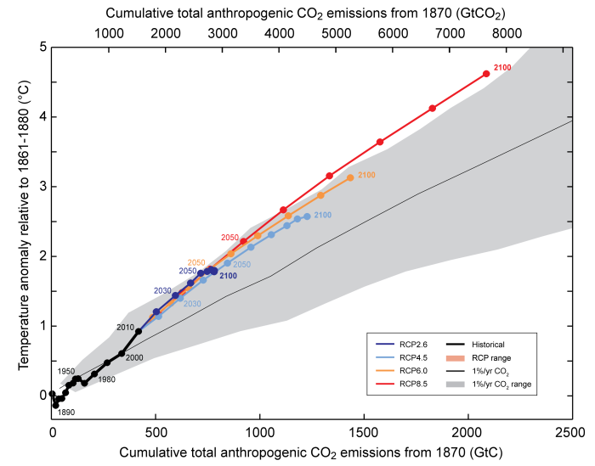
Warming caused by cumulative carbon emissions to 2100

Slide 23
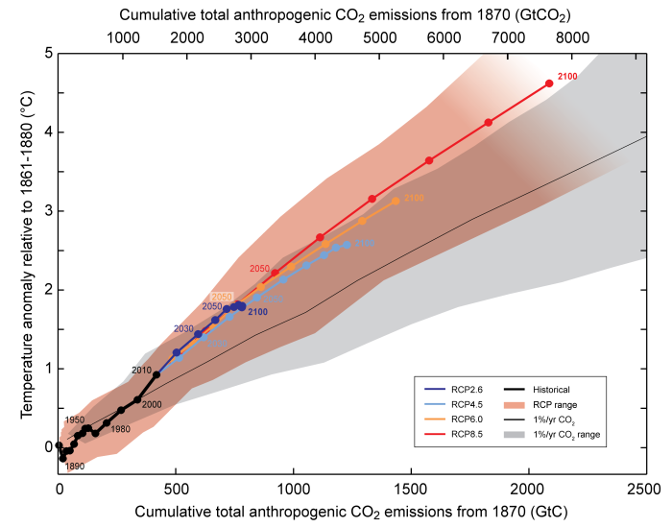
Warming caused by cumulative carbon emissions to 2100

Slide 24
To limit CO₂-induced warming to likely below 2ºC, cumulative CO₂ emissions must be limited to 1000 GtC.

Slide 25
To limit anthropogenic warming to likely below 2ºC, cumulative CO₂ emissions must be limited to 800 GtC
(when accounting for warming from non-CO2 forcing)

Slide 26

Cumulative emissions 1870–2013 are 550 ±60 GtC
70% from fossil fuels and cement, 30% from land-use change
That leaves about 250 GtC for the future.
That’s about 25 years at the current emission level (10 GtC/yr)

Slide 27
Anthropogenic CO2 emissions above 10 GtC/yr in 2012, ~60% above 1990
Current rate of increase about 2% per year
CO2 represents, by far, the largest contributor to the anthropogenic radiative forcing (> 80%)
Global warming scales with cumulative CO2 emissions
Limiting global warming likely below 2°C requires emissions to stay below about 800 GtC since preindustrial.
550 GtC already emitted, 250 GtC left for the future…

