Slide 1
“The BELGIAN SHORT TIME WORK SCHEME”
Study Morning Belspo
8 December 2025
David Rozenblum & Marie-Noëlle Vanderhoven
CC. Werk en Sociale Zekerheid
CC. Emploi et Sécurité Sociale

Slide 2
Reflexions from a political insight

Slide 3
reflexions from a political insight
Psychological impact .. for all
Structural use or « new normal » ?

Slide 4
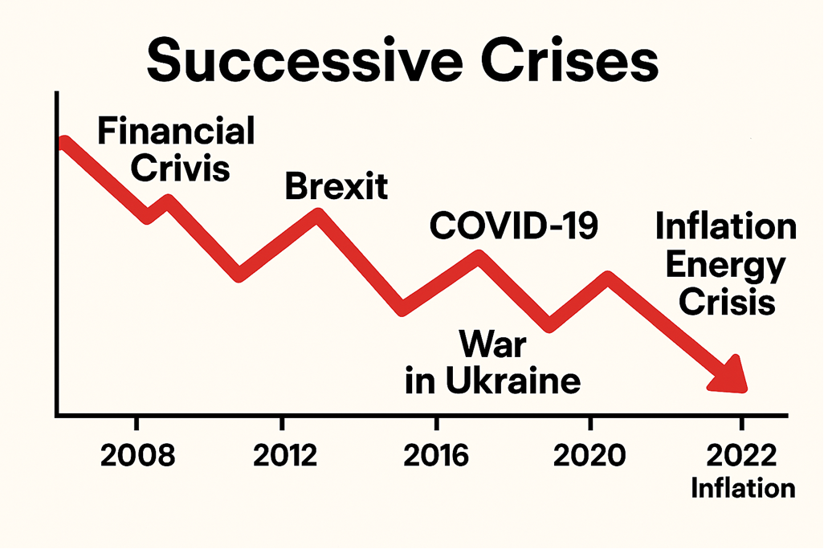
reflexions from a political insight

Slide 5
reflexions from a political insight
Uncertainties ?
Turning uncertainties into opportunities
Bill + check + sum ..
Regulatory environment

Slide 6


