Slide 1








The Belgian Short-Time Work Scheme: Economic and Psychological Impacts. Pathways to a More Effective and Human Policy Policy Recommendations
December 8, 2025
Natalia Bermúdez, Bart Cockx, Nele De Cuyper, Muriel Dejemeppe, Hans De Witte, Charlotte Rodriguez, Florence Stinglhamber, and Giulia Tarullo

Slide 2
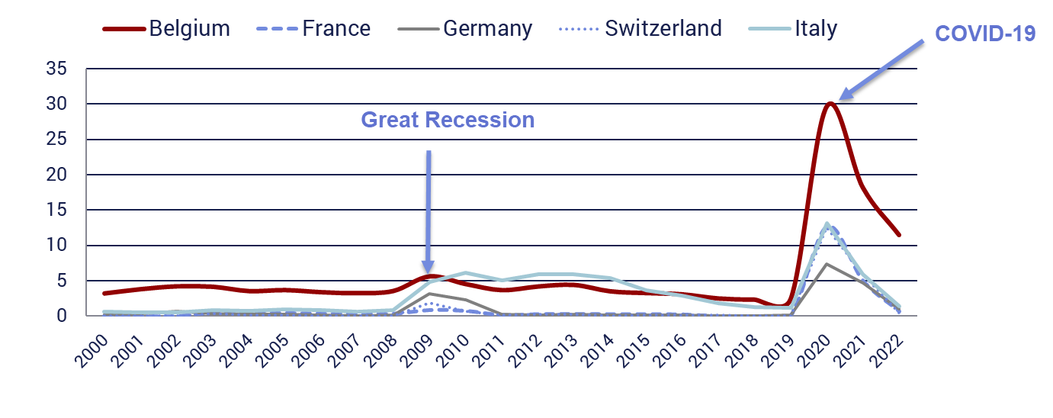

Key Issue: High Uptake of Short-Time Work (STW) in Belgium

Slide 3
Design Features Aligned with Short-Time Work Objectives
STW aims to support firms and workers during unexpected & temporary economic shocks
Flexible:
Simple and rapid access is essential
Targeted:
Restrict to firms that truly need it
Economic: Prevent deadweight costs
Psychological: Reduce stress linked to STW use
Temporary:
Avoid prolonged use — it is costly
Economic: Slows efficient job reallocation
Psychological: Increases job insecurity with limited ability to draw on employability => reduces motivation

Slide 4
Dealing with Design Tensions
Targeting based on objective criteria?
Which indicators?
Asymmetric info difficult choice + costly to verify
Trade-off: Slow procedures responsive and temporary support
Examples:
White collar scheme in Belgium
STW in Switzerland during the Great Recession
Targeting based on financial incentives = “responsibility contribution”?
Employers contribute partially to STW costs (as best informed)
Key features:
Delayed payment liquidity constrained firms = target
Incentives start at low STW use + premium at worker level
Stakeholder as information gatekeeper (worker/trade union?)

Slide 5
Dealing with Psychological Well-Being
Even if STW improves well-being relative to layoffs, it can still:
Reduce workers’ sense of control and increase stress (vs. stable employment)
Negatively affect organizational functioning lower productivity
Especially when use is limited (e.g., one firm in a sector, few workers within firm)
Policy Implications:
Limit use to where it is truly needed
If STW is unavoidable, provide support:
Transparent communication: why is STW applied and how is it distributed within firm
Follow-up and support to reduce insecurity
Enhance feeling of employability: offer and subsidize firm- specific training in the short-run

Slide 6
Summary of Policy Recommendations
Enhance the scheme’s:
Flexibility:
Keep simple access for blue-collars and simplify it for white-collars
Abolish complex eligibility criteria for white-collars
Targeting
Reinforce responsibility contribution (RC): start at lower levels of use
Temporary nature:
Lengthen interruption periods between successive STW episodes
Remove recently introduced job search requirement after 3 months
Support
Ensure transparent communication within firms
Incentivize spread of STW uptake across the workforce by RC/worker
Follow-up + offer firm-specific training no general training!

Slide 7
Thank you!

