Slide 1








Protecting Jobs in Times of Crisis:
Evidence on Short-Time Work in Belgium
December 8, 2025 - Brussels, Belgium
Natalia Bermúdez*, Bart Cockx^{ǂ}, Muriel Dejemeppe^{Ϯ}, Giulia Tarullo¶
* IRES/LIDAM, UCLouvain; Department of Economics, UGent
ǂ Department of Economics, UGent; IRES/LIDAM, UCLouvain
Ϯ IRES/LIDAM, UCLouvain
¶ RWI – Leibniz Institute for Economic Research (Germany); IRES/LIDAM, UCLouvain; Department of Economics, UGent

Slide 2
Table of Contents
Motivation & Context
Research Objective & Key Questions
Evaluating STW: Challenge & Solution
Study 1: Great Recession
Study 2: COVID-19 Crisis
Study 3: Financial Contributions & Overuse
Conclusion

Slide 3

What is Short-Time Work?
(Belgium: “Temporary Unemployment”)
A tool allowing temporary reductions in working hours instead of layoffs
Firms temporarily reduce working hours (partially or fully)
Employers pay wages for hours worked
Government partially compensates workers for hours not worked
Employment relationships are maintained
Belgian features
Mainly used for economic reasons (~70% of applications)
Rules differ for blue-collar (more flexible) vs white-collar workers
Other reasons: bad weather, force majeure (e.g. COVID)
“Responsibility contribution” introduced to curb overuse

Slide 4
Why does STW exist? (The Problem)
STW addresses inefficiencies during economic shocks
During downturns, layoffs can become inefficiently high
Firms have limited ability to hoard labor due to:
  Liquidity constraints (imperfect financial markets)
  Rigid wages and working hours (limited bargaining flexibility)
  Traditional unemployment insurance protects workers only after separation, not employment relationships
Notes:
In this way traditional unemployment reinforces layoffs -> especially for workers where EPL are weaker, or have low attachement to employers.

Slide 5
Why does STW exist? (The Benefits)
STW provides temporary insurance for firms, workers, and the economy
Avoids excessive layoffs
Preserves firm-specific skills and reduces firing/rehiring costs
Limits workers’ income losses and long-term scarring
Stabilizes aggregate demand and reduces fiscal costs
In essence, STW allows firms to hoard labor temporarily while maintaining jobs

Slide 6
STW Trade-Offs: Deadweight Effects
Poorly targeted STW can create inefficiencies
Cause: Limited government information
Cannot observe whether the shock is sufficiently strong to justify STW
Cannot observe whether the shock is temporary or structural
Cannot know whether firms could absorb the shock internally
Consequence: Firms may use STW even when jobs are not at risk
Result: Public resources are used without employment gains

Slide 7
STW Trade-Offs: Slower Labor Reallocation
STW may slow down the natural movement of workers
Workers may remain in jobs or sectors that are no longer viable
Delays movement toward more productive firms/sectors
Effects are more pronounced during long or structural crises
Careful policy design is needed to balance job protection with efficient labor allocation
Notes:
As reallocation can be productivity enhancing.

Slide 8
STW Uptake in Selected OECD Countries
STW uptake (% of eligible workers)
COVID-19
Great Recession
Belgium relies heavily on STW, not only during downturns but also in stable periods ⇒ risk of deadweight effects and misallocation of labor

Slide 9
Research Objective and Key Questions
Objective: Evaluate STW’s economic impact in Belgium
Key questions:
1. What is the impact of STW on firm-level employment?
  During the Great Recession (GR) and COVID-19
  In the short and medium term
2. Do effects differ across:
  Sectors more exposed to economic shocks
  Job types (blue-collar vs white-collar)
3. Can the “responsibility contribution” curb excessive STW use while still protecting jobs?

Slide 10
Evaluating STW: Challenge & Solution
Challenge:
Firms self-select into STW → differ in size, sector, financial health…
Simple comparisons confound STW effects with firm characteristics
Cannot observe what would have happened without STW
Solution:
Use quasi-experimental methods → find a “perfect clone” → a similar firm that did not use STW (or used it less)
Provides a credible comparison to estimate STW’s real impact
Takeaway:
Rigorous methods are essential to measure the real effect of STW

Slide 11
Study 1: STW During the Great Recession
Objective
Estimate the causal effect of STW on employment during the 2008–2009 crisis in Belgium
Context
Demand shock; manufacturing most exposed via global trade links
Focus on small firms (5–49 employees) and blue-collar workers
Data
Micro-aggregated firm-level data (2004–2012): employment, STW use, VAT data

Slide 12
Study 1: Method
Approach
Instrumental Variable (IV) strategy
Exploit variation in STW eligibility between blue- and white-collar workers
  Firms with more blue-collar employees use STW more for the same shock [graph]
“Perfect Clone” analogy
For a similar negative shock → Compare firms that use STW to similar firms that use it less because they have fewer blue-collar workers
Provides a credible estimate of the STW’s causal effect on employment

Slide 13
Study 1: Key findings
Short-term effects
Manufacturing: 1-FTE increase in STW → ~0.5 jobs saved
Non-manufacturing: STW used extensively, but for jobs not at risk → deadweight effects
Medium-term effects
Employment gains fade after the first year
Structural adjustments (downsizing, automation, etc.) limit STW’s impact and can delay—but not prevent—necessary restructuring
Takeaway
STW is effective where jobs are genuinely at risk
Effects are heterogeneous across sectors

Slide 14
Study 2: STW During the COVID-19 Crisis
Objective
Estimate the causal effect of STW on employment during the COVID-19 pandemic in Belgium
Context
Major demand and supply shock due to lockdowns
Exceptionally high STW take-up, especially in contact-intensive sectors
Data
High-frequency firm-level data (2018–2022): employment and STW use
Covers all workers (blue- and white-collar).
Notes:
Mention that the research cannot evaluate firms in which all workers were affected by lockdown + briefly explain the distinction between partially and not affected firms.

Slide 15
Study 2: Method
Approach
Fuzzy Regression Discontinuity Design (RDD)
Exploit policy rule limiting access to the simplified STW program (“force majeure”)
Institutional rule
September 2020: firms eligible for simplified STW only if ≥20% of workdays were in STW in Q2-2020, except for firms fully affected by the lockdown
“Perfect Clone” analogy
Compare similar firms just above and below the 20% threshold [graph]
They differ only in STW intensity, mimicking an experiment
Notes:
Mention that the research cannot evaluate firms in which all workers were affected by lockdown + briefly explain the distinction between partially and not affected firms.

Slide 16
Study 2: Key findings
Short- and medium-term effects
Partially-locked down firms: persistent STW use → lasting employment gains (until 2022Q4)
Lockdown-unaffected firms: STW use did not increase employment → deadweight effects
Heterogeneous effects by workforce composition
White-collar-intensive firms: larger short- and medium-term employment gains
Blue-collar-intensive firms: high STW use but smaller employment gains
Takeaway
Simplified STW access helped firms constrained by lockdowns
Effects are heterogeneous across sectors and workforce types

Slide 17
Study 3: Financial Contributions to Limit STW Overuse
Objective:
Evaluate firms’ reactions to the “responsibility contribution” (2005 & 2012)
Impact on STW use, coverage, productivity, and liquidity
Institutional rule (blue-collar workers)
Penalty when >110 STW days/worker/year
Applied after one year
Contribution based on intensity per worker
Firm behaviours
Bunching just below 110 days
Non-bunching → pay penalty and adjust elsewhere
≈ €46/day (construction, 2005)
≈ €20/day (other sectors, 2012)
Notes:
Applied after one year: avoids discouraging firms facing short-term liquidity issues

Slide 18
Study 3: Method
Approach
Bunching design, exploiting firms’ strategic behaviour around the 110-day threshold
Intuition
Compare the observed distribution of STW days/worker around 110 days
To a “clone” distribution” expected without financial contributions
Differences directly reflect firms’ responses to the penalty
[graph]

Slide 19
Study 3: Key findings
Effectiveness
Financial contributions curbed overuse, but the high threshold limited impact
Only ~13% of STW users were affected → marginal overall reduction
Behavioral responses
STW days above threshold ↓ (~5 days/worker), stronger for high-wage workers
Firms spread reductions across more workers (full-time, men, aged 30–55)
Unintended effects (limited)
For firms paying the penalty, employment, wages, and liquidity remain stable
Takeaway
Penalties work, but threshold too high → limited effect on aggregate overuse
Notes:
? with stronger reactions among high-wage workers: Those workers

Slide 20
Overall Conclusions
STW is effective when shocks are large and temporary
• During both the Great Recession and COVID-19, STW prevented substantial job losses in crisis-exposed sectors
• Firms buffered shocks while preserving valuable human capital
Effectiveness depends on context and design
• When firms are genuinely hit (e.g., manufacturing in 2008–09, contact-intensive sectors during COVID-19), STW generates clear employment gains
• When firms are less affected, STW mainly protects jobs not at risk → deadweight effects
• For structurally declining firms, STW mainly delays necessary adjustments

Slide 21
Key Cross-Study Insights
Access rules shape both targeting and efficiency
Easy access in non-exposed sectors (GR) and simplified access for not-affected firms (COVID-19) amplified inefficiencies
Evaluation of simplified access during COVID-19 shows - more flexible access for white-collar workers could further strengthen the system’s effectiveness
Overuse exists in and outside crises
Generous access in good times reduces the system’s role as an automatic stabilizer
Financial contributions curb overuse only mildly, as few firms reach the high penalty threshold

Slide 22
Thank you
Contact: natalia.bermudez@uclouvain.be
(*) A non-technical summary of the research findings is published in two academic reviews:
- Gentse Economisch Inzichten (in Dutch)
- Regards économiques (in French)

Slide 23
Study 1: Method
Instrumental variable intuition
Institutional feature: Much more lenient STW eligibility for blue-collar than for white-collar workers
→Firms with high blue-collar shares increase STW use more strongly for a given shock in demand

Slide 24
Study 2: Method
Firms that could not operate at full capacity because of lockdowns
Partially lockdown-affected firms (*)
Fuzzy Regression Discontinuity Design
intuition
We exploit a policy rule to mimic an experiment:
Compare similar firms above and below the 20%-threshold to measure STW’s impact
They only differ in the intensity of STW use in 2020Q2): firms to the left-hand side use the program in less intensity
(*) Firms that had joint committees (“commission paritaire” in french) that were in the list of hardest hit sectors.

Slide 25
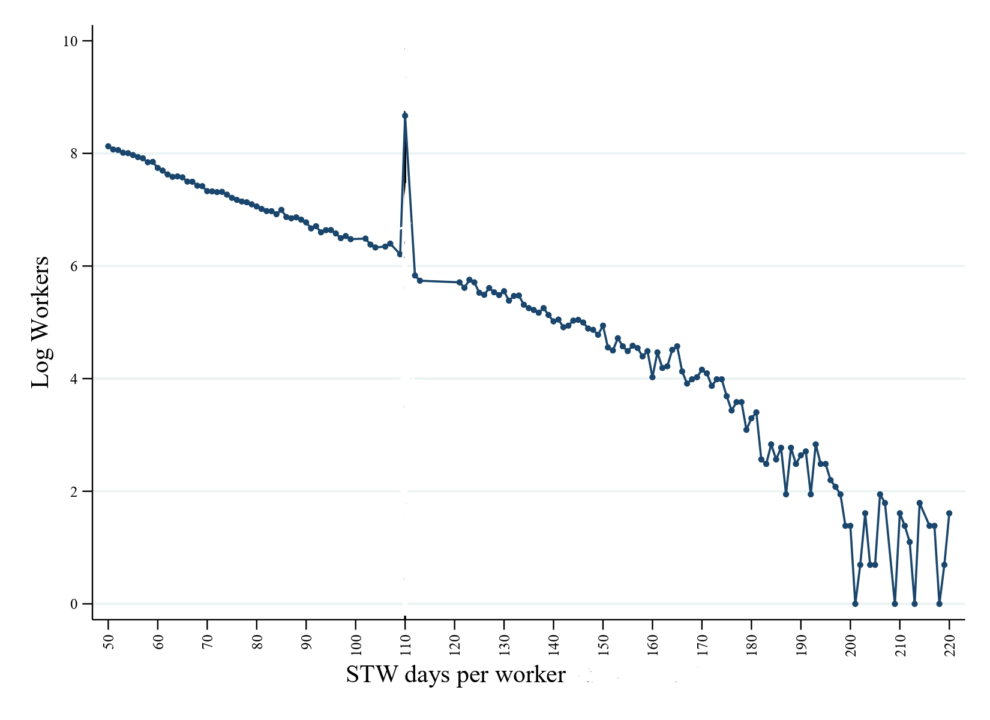
Study 3: Method
Bunching design
intuition
Compare distribution of STW days per worker around the 110-day threshold, after the reform, relative to the ‘clone’ distribution absent the reform
Pre- and post-reform distributions differ only because of financial contributions at the 110-day threshold and firms’ strategic adjustments to them

