Slide 1








The Bright and Dark Sides of STW: A Psychological Perspective on Well-being and Employability
December 8, 2025
Charlotte Rodriguez Conde, Nele De Cuyper, Hans De Witte and Florence Stinglhamber

Slide 2

Table of contents
01
02
State of the art and gaps
Research overview: studies and samples
03
04
Study 1: STW as an alternative to lay-off
Study 2: STW and qualitative job insecurity
05
06
Final Conclusion
Study 3: STW and profiles of employment security

Slide 3

01
State of the art and gaps

Slide 4


Why do we need a psychological perspective on STW?
Employer’s intention
Limited research but emerging concerns after its massive use during the pandemic
Despite the protection offered, STW remains a disruptive event
Worker’s subjective perception and experience
Risk of insecurity & stress

Slide 5

What we know about STW:
STW has a bright side…
Job objectively not lost – at least in the short-term (Blomqvist et al., 2021)
Opportunity to recover (e.g., Halbesleben et al., 2013)
…but also a dark side
Subjective perception that the job can be lost (Klug et al., 2024)
Breach of the psychological contract and turnover intentions (Delegach et al., 2024; Huffman et al., 2021)

Slide 6

What we still do not know about STW
Okay, STW is less harmful than job loss in the short-term…
…but what about the long term?
…but does the context (e.g., pandemic, country, industry…) matter?
Okay, STW may reveal the risk of losing one’s job…
…but is the risk only about losing one’s job?
…but what about the ability to find another job (i.e., employability)?

Slide 7

02
Research overview: studies & data

Slide 8
Study 1: STW as an alternative to lay-off
Study 2: STW and qualitative job insecurity
Study 3: STW and profiles of employment security
Objectives
1) Investigate LT well-being
2) Examine the influence of context (i.e., perception of the crisis and its severity)
Objectives
1) Examine concerns regarding job quality
Objectives
1) Propose a broader
definition of employment
insecurity that includes perceived employability
2) Examine the relationship between employment insecurity and STW
2) Account for differences in workers (i.e., industry, managerial position; full-time/part-time)
Recommendations
based on literature and existing schemes in other European countries
Context
Data collected >1 year after the pandemic crisis
Context
Data collected (twice – 2 months apart) during the first months of the pandemic
Context
Data collected (twice – 6 months apart) in the aftermath of the energy crisis

Slide 9

Samples & data (1/2)
One of the BIGGEST challenge in this research…
…but THANKS to our different partners
2 big samples collected at different times via different channels:
During the pandemic (March-June 2020): via an external service for prevention and protection at work, N =1840 (STW: 260), longitudinal data (2 months apart)
In the aftermath of the energy crisis (> 1 year after the pandemic, 2023-2024): via social network/trade unions, N =2655 (STW during the pandemic: 1378; STW in the past 6 months: 153), longitudinal data (6 months apart)
Study 2
Studies 1 & 3

Slide 10
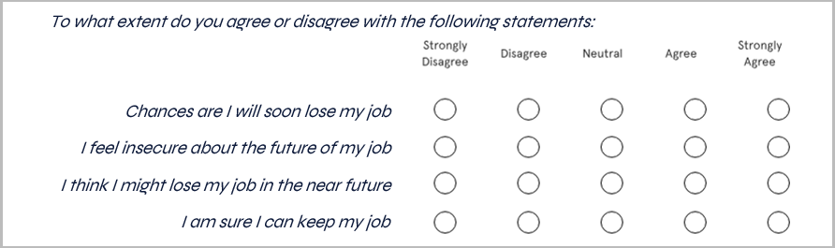
Samples & data (2/2)
Online questionnaires in Dutch, French & English
Sociodemographics & Likert-type scales measuring subjective perceptions
e.g., job insecurity (i.e., the fear of losing one’s job in the future; Vander Elst et al., 2014):

Slide 11
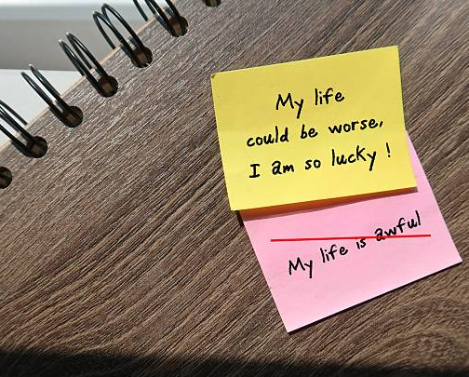
03
Study 1: STW as an alternative to lay-off

Slide 12

Study purpose
Is STW a lesser evil option than job loss in the long run?
Comparison of 3 workers groups (including « stable employment »)
Psychological mechanism:
Perception of reduced control as a stressor
Contextual influence: scale of the crisis (i.e., whether a minority or majority of workers are impacted)
Mental health
+
STW VS
Job loss VS Stable employment
Perceived control over the employment situation
+
Physical health

Slide 13
Results
Bright side: STW associated with higher levels of control and well-being than job loss
STW still offers protection >1 year after the crisis
Dark side: When few workers affected by STW, ↓ perceived control compared to stable employment (n.s. effect when STW is widespread)
Lesser evil
Implications: context matters (large-scale vs use in specific contexts (e.g., isolated organization or few affected workers))

Slide 14
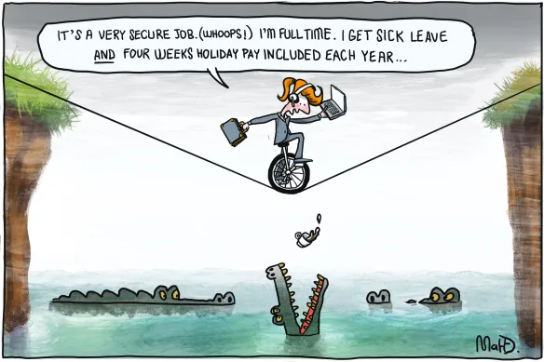
04
Study 2: STW and qualitative job insecurity

Slide 15
Study purpose (1/2)
Is STW associated with worries about the future quality of the job (i.e., qualitative job insecurity)?
Changes in working conditions or job content more likely than job loss in certain contexts (i.e., early stage of the pandemic)
Qualitative job insecurity is a stressor
Job Satisfaction (T2)
Short-Time Work
vs
No Short-Time Work
(T1)
-
Qualitative Job Insecurity (T1)
+
+
Psychological Distress (T2)

Slide 16




Study purpose (2/2)
Does everyone react in the same way?
Workers in more central positions less accustomed to insecurity
Workers in certain industries less accustomed to STW and its insecurity
+
Part-Time vs Full-Time
Employees vs Managers
Are there differences between these different groups of workers?
Sectors usually impacted by STW vs Sectors usually not impacted (healthcare sector not included)

Slide 17
Results (1/2)
Dark side: STW -> ↑ qualitative job insecurity -> ↓ job satisfaction
Insecurity beyond worries about future job loss
Bright side: STW not associated with ↑ psychological distress 2 months later despite ↑ qualitative job insecurity
Potential explanations: recovery, reduced exposure to work stressors during the pandemic

Slide 18
Results (2/2)
STW more stressful for groups of workers who typically experience greater job security (i.e., managers, full-time, industries usually not impacted by STW)
STW more or less disruptive
Implications: short-term concerns are stressful and signal potential long-term changes
Need to monitor job quality over time

Slide 19

05
Study 3: STW and profiles of employment security

Slide 20
Study purpose
Does STW also affect the perceived ability to find another job if needed?
Employment security also comes from employability within and outside the organization
Person-centered approach to observe « profiles »
job at risk
STW may send mixed signals
employer’s wish to retain skilled workers

Slide 21
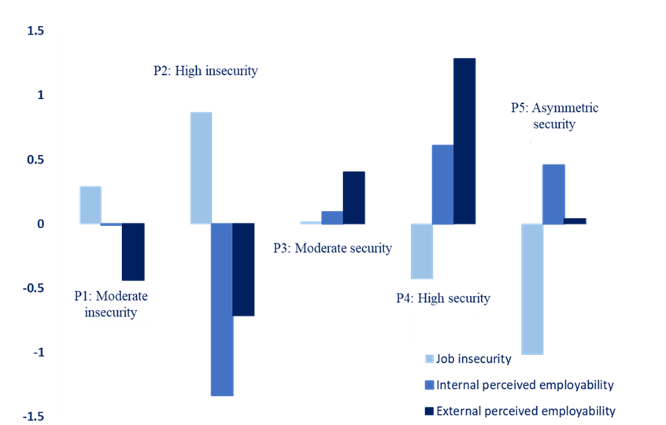
Results (1/2)
5 profiles of employment (in)security
12.21%
16.32%
19.46%
13.17%
38.85%
No profile showing moderate to high levels of job insecurity and perceived employability

Slide 22
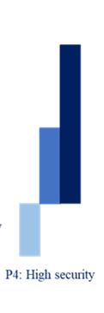
Results (2/2)
Dark side: STW (up to 6 months before) more frequently associated with profiles showing low employment security
More vulnerability (↓ well-being)
Bright side: some (but only a minority) of STW workers maintain employability with low job insecurity
Employability as a protective factor

Slide 23

06
Final conclusion

Slide 24

Results overview (1/2)
STW is generally beneficial for workers’ well-being:
STW remains a lesser evil than job loss
STW might be particularly protective (1) in the context of a global crisis (2) when implemented under favorable conditions
From a psychological perspective, we recommend the use of STW

Slide 25
Results overview (2/2)
That said, 3 key areas of concerns : (1) the loss of control during the crisis, (2) the quantitative and qualitative insecurity in the short and long term, (3) the need to strengthen perceived employability
Potential consequences on well-being, but also on organizations

Slide 26

Thank you
And you, what do you think about our findings?
Special thanks to:
IDEWE, ACV-CSC, FGTB-ABVV and the SocLab for their support in data collection
Stockholm University for their warm welcome and hosting
Our co-authors: Claudia Bernhard-Oettel, Tinne Vander Elst, Sofie Vandenbroeck, & Lode Godderis
Contact: charlotte.rodriguezconde@kuleuven.be / charlotte.rodriguez@uclouvain.be

